Slide 1

CanSat 2024 Preliminary Design Review (PDR) Outline Version 1.1
Team 2031
Eggsplorer 1

Slide 2
Presentation Outline
Page #​ | Presentation Section​ | Presenter(s)​
5 | Systems Overview​ | Zachary DeFabrizio, Jake Edwards, Max Epstein, Melissa Gonzalez, Samuel Taylor
21 | Sensor Subsystem Design​ | Jonathan (Yoni) Gutmann
32 | Descent Control Design​ | Melanie Miguel, Jake Edwards, Samuel Taylor, Zachary DeFabrizio, Christian Roque
41 | Mechanical Subsystem Design​ | Zachary DeFabrizio, Jake Edwards, Melissa Gonzalez, Jonathan (Yoni) Gutmann, Melanie Miguel, Christian Roque, Samuel Taylor
54 | Communication and Data Handling (CDH) Subsystem Design​ | Evan (Steele) Elliott, Sanat Konda
65 | Electrical Power Subsystem (EPS) Design​ | Jonathan (Yoni) Gutmann
70 | Flight Software (FSW) Design​ | Evan (Steele) Elliott
80 | Ground Control System (GCS) Design​ | Evan (Steele) Elliott, Sanat Konda
87 | CanSat Integration and Test​ | Evan (Steele) Elliott, Max Epstein, Melissa Gonzalez
95 | Mission Operations & Analysis​ | Max Epstein, Melissa Gonzalez
100 | Requirements Compliance​ | Max Epstein
109 | Management​ | Max Epstein, Melissa Gonzalez
Presenter: Melissa Gonzalez

Slide 3
Team Organization
Faculty Advisor
Norman Fitz-Coy
Team Lead
Melissa Gonzalez
Junior
Team Lead
Max Epstein
Junior
Descent Control Subsystem
Mechanical Subsystem
Avionics Subsystem
Flight Software Subsystem
Christian Roque
Sophomore
Zachary DeFabrizio
Sophomore
Jonathan (Yoni) Gutmann
Junior
Evan (Steele) Elliott
Junior
Melanie Miguel
Sophomore
Samuel Taylor
Freshman
Sanat Konda
Sophomore
Jake Edwards
Freshman
Presenter: Max Epstein

Slide 4
Acronyms
Acronym | Meaning
ABS | Acrylonitrile Butadiene Styrene
CD | Drag Coefficient
CDH | Communication and Data Handling
CSV | Comma-Separated Values
DAC | Digital-to-Analog Converter
EPS | Electrical Power Subsystem
FSW | Flight Software
GCS | Ground Control System
GPS | Global Positioning System
IDE | Integrated Development Environment
LED | Light-Emitting Diode
Acronym | Meaning
MAE | Mechanical & Aerospace Engineering
OTS | Off-the-shelf
PDR | Preliminary Design Review
PID | Proportional-Integral-Derivative
PWM | Pulse-Width Modulation
RPM | Revolutions per Minute
SMA | Subminiature Version A
SPI | Serial Peripheral Interface
SSDC | Space Systems Design Club
STEM | Science, Technology, Engineering, and Mathematics
UF | University of Florida
Presenter: Melissa Gonzalez

Slide 5
Systems Overview
Zachary DeFabrizio, Jake Edwards, Max Epstein, Melissa Gonzalez, Samuel Taylor

Slide 6
Mission Summary (1/2)
Main Objectives:
Design a CanSat that shall simulate a space probe entering a planetary atmosphere while carrying a delicate instrument.
The CanSat shall act and operate as the nosecone during ascent
The CanSat must survive the forces at launch and deployment
The CanSat shall be launched to a maximum altitude of 725 meters above the launch site and deployed near apogee (peak altitude)
The CanSat shall measure the speed of the rocket during both ascent and descent with a pitot tube
The CanSat shall open an aerobraking heatshield which should have a descent rate of between 10 to 30 meters per second and not tumble
At 100 meters, the CanSat shall detach the aerobraking heatshield and simultaneously release a parachute, reducing the descent to 5 meters per second or less
The CanSat shall land with the egg intact
The camera shall point in one direction and maintain that direction through the descent
Presenter: Max Epstein

Slide 7
Mission Summary (2/2)
Bonus Objective:
A video camera shall be integrated into the CanSat and point aft of the CanSat. The camera shall capture the CanSat being deployed from the rocket and the release of the parachute. Video shall be in color with a minimum resolution of 640x480 pixels and a minimum of 30 frames per second. The video shall be recorded and retrieved when the CanSat is retrieved.
We will not be attempting the bonus objective
External Objectives:
To promote STEM engagement at the university level
To provide team members with valuable hands-on engineering project experience that includes designing, manufacturing and testing of an aerospace system
To challenge students with unique projects that require critical thinking
To inspire underclassmen to continue participating in the annual CanSat competition at UF
Presenter: Max Epstein

Slide 8
System Requirement Summary (1/7)
Requirement Number | Description
C1 | The CanSat will act as the nose cone during the rocket’s ascent portion of the flight.
C2 | The CanSat shall be deployed when the ejection charge fires.
C3 | After deployment, the CanSat shall deploy its heat shield/aerobraking mechanism.
C4 | A silver or gold mylar streamer of 50 mm width and 1.5 meters in length shall be connected to the CanSat and released at deployment, used to locate and identify the CanSat.
C5 | At 100 meters, the CanSat shall deploy a parachute and release the heat shield.
C6 | Upon landing, the CanSat shall stop transmitting data.
C7 | Upon landing, the CanSat shall activate and audio beacon.
C8 | The CanSat shall carry a provided large hen’s egg with a weight between 51 and 65 grams.
C9 | 0 altitude reference shall be at the launch pad
C10 | During descent with the heat shield deployed, the descent rate shall be between 10 and 30 m/s.
C11 | At 100 meters, the CanSat shall have a descent rate of less than 5 m/s.
C12 | Total cost of the CanSat shall be below $1000. Ground support and analysis equipment are not included in this cost. Equipment from previous years shall be included at current market price.
Presenter: Max Epstein

Slide 9
System Requirement Summary (2/7)
Requirement Number | Description
S1 | The CanSat mass shall be 900 grams +/- 10 grams without the egg.
S2 | The nose cone shall be symmetrical along the thrust axis.
S3 | The nose cone radius shall be exactly 71 mm.
S4 | The nose cone shoulder radius shall be exactly 68 mm.
S5 | The nose cone shoulder length shall be a minimum of 50 mm.
S6 | CanSat structure must be able to survive 15 Gs vibration.
S7 | CanSat shall must survive 30 Gs shock.
S8 | The CanSat shall perform the function of the nose cone during rocket ascent.
S9 | The rocket airframe can be used to restrain any deployable parts of the CanSat, but shall allow the CanSat to slide out of the payload section freely.
S10 | The rocket airframe can be used as part of the CanSat operations.
S11 | All electronics and mechanical components shall be hard mounted using proper mounts such as standoffs, screws, or high performance adhesives.
Presenter: Max Epstein

Slide 10
System Requirement Summary (3/7)
Requirement Number | Description
M1 | No pyrotechnical or chemical actuators are allowed.
M2 | Mechanisms that use heat shall not be exposed to the outside environment to reduce risk of setting the vegetation on fire.
M3 | All mechanisms shall be capable of maintaining their configuration or states under all forces.
M4 | Spring contacts shall not be used for making electrical connections to batteries as shock forces can case momentary disconnects.
M5 | The CanSat shall deploy a heat shield after deploying from the rocket.
M6 | The heat shield shall be used as an aerobrake and limit the descent rate to 10 to 30 m/s.
M7 | At 100 meters, the CanSat shall release a parachute to reduce the descent rate to less than 5 m/s.
M8 | The CanSat shall protect a hen’s egg from damage during all portions of the flight.
M9 | If the nose cone is to be considered part of the heat shield, the documentation shall identify the configuration.
M10 | After the CanSat has separated from the rocket, and if the nose cone portion of the CanSat is to be separated from the rest of the CanSat, the nose cone portion shall descent at less than 10 m/s using any type of descent control device.
Presenter: Max Epstein

Slide 11
System Requirement Summary (4/7)
Requirement Number | Description
E1 | Lithium polymer batteries are not allowed.
E2 | Battery source may be alkaline, Ni-Cad, NiMH or Lithium. Lithium cells must be manufactured with a metal package similar to 18650 cells. Coin cells are allowed.
E3 | The power switch must be easily accessible.
E4 | There must be a power indicator.
E5 | The CanSat shall operate for a minimum of two hours when integrated into the rocket.
X1 | XBEE radios shall be used for telemetry. 2.4 GHz Series in addition to 900 MHz Series are allowed.
X2 | XBEE radios shall have their NETID/PANID set to their team number.
X3 | XBEE radios shall not use broadcast mode.
X4 | The CanSat shall transmit telemetry once per second.
X5 | The CanSat telemetry shall include altitude, air pressure, temperature, battery voltage, tilt angles, air speed, command echo, and GPS coordinates which include latitude, longitude, altitude, and number of satellites.
Presenter: Max Epstein

Slide 12
System Requirement Summary (5/7)
Requirement Number | Description
SN1 | CanSat shall measure its speed with a pitot tube during both ascent and descent.
SN1 | CanSat shall measure its altitude using air pressure.
SN3 | CanSat shall measure its internal temperature.
SN4 | CanSat shall measure its angle stability with the aerobraking mechanism deployed.
SN5 | CanSat shall measure its rotation rate during descent.
SN6 | CanSat shall measure its battery voltage.
SN7 | The CanSat shall include a video camera pointing horizontally.
SN8 | The video camera shall record the flight of the CanSat from launch to landing.
SN9 | The video camera shall record video in color and with a minimum resolution of 640x480.
Presenter: Max Epstein

Slide 13
System Requirement Summary (6/7)
Requirement Number | Description
G1 | The ground station shall command the CanSat to calibrate the altitude to zero when the CanSat is on the launch pad prior to launch.
G2 | The ground station shall generate csv files of all sensor data as specified in the Telemetry Requirements section.
G3 | Telemetry shall include mission time with 1 second or better resolution.
G4 | Configuration states such as zero altitude calibration shall be maintained in the event of a processor reset during launch and mission.
G5 | Each team shall develop their own ground station.
G6 | All telemetry shall be displayed in real time during descent on the ground station.
G7 | All telemetry shall be displayed in engineering units and the units shall be indicated on the displays.
G8 | Teams shall plot each telemetry data field in real time.
G9 | The ground station shall include one laptop computer with a minimum of two hours battery operation, XBEE radio, and an antenna.
G10 | The ground station must be portable so that the team can be positioned at the ground station operation site along the flight line. AC power will be not available.
G11 | The ground station software shall be able to command the payload to operate in simulation mode by sending two commands, SIMULATION ENABLE and SIMULATION ACTIVATE.
Presenter: Max Epstein

Slide 14
System Requirement Summary (7/7)
Requirement Number | Description
G12 | When in simulation mode, the ground station shall transmit pressure data from a csv file provided by the competition at 1 Hz interval to the CanSat.
G13 | The ground station shall use a table top or handheld antenna.
G14 | The displays on the ground station shall be designed with larger fonts (14pt minimum), bold plot traces and axes, and dark text on a light background since the ground station will be viewed in bright sundlight.
G15 | The ground system shall count the number of received packets. This is not the number of transmitted packets but the number of packets successfully received at the ground station.
F1 | The flight software shall maintain a count of packets transmitted which shall increment with each packet transmission through the mission. This value shall be maintained through processor resets.
F2 | The CanSat shall maintain mission time throughout the whole mission regardless of processor resets or power loss.
F3 | The CanSat shall have its time set to within one second UTC time prior to launch.
F4 | The flight software shall support simulated flight mode where the ground station sends air pressure values at a one second interval using a provided flight profile csv file.
F5 | In simulation mode, the flight software shall use the radio uplink pressure values I place of the pressure sensor for determining the payload altitude.
F6 | The payload flight software shall only enter simulation mode after it receives the SIMULATION ENABLE and SIMULATION ACTIVE commands.
Presenter: Max Epstein

Slide 15
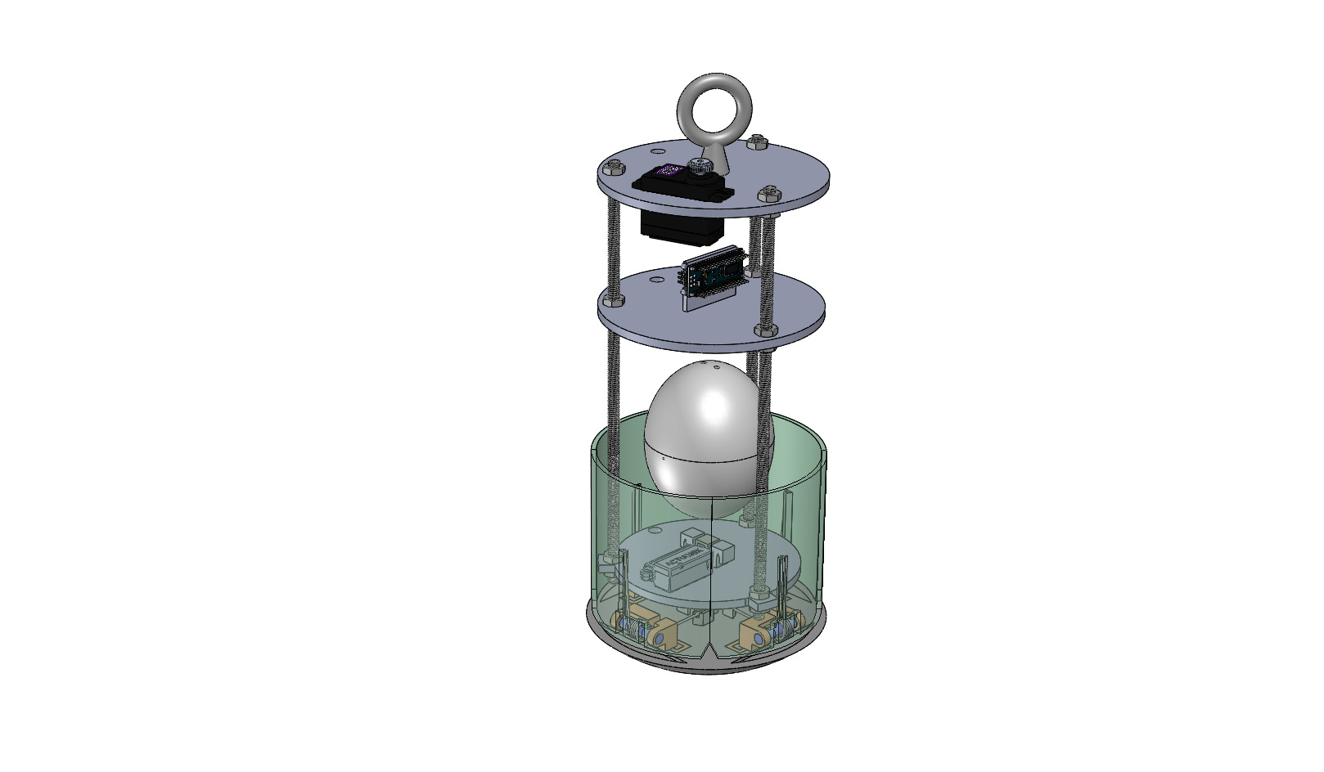
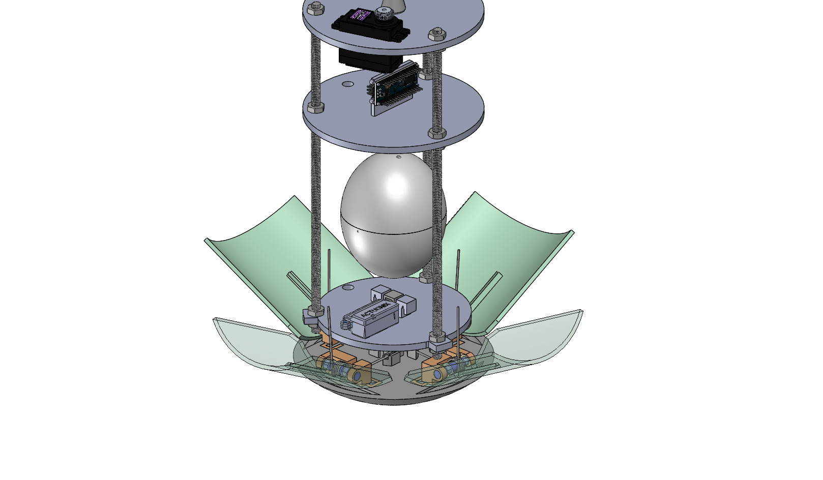
System Level CanSat Configuration Trade & Selection (1/2)
System Design 1
Eyebolt for parachute attachment
Servo motor for parachute release
Triple threaded rod support beams
Activated heat shield
ABS support platforms
Suspended oval shaped egg capsule
Linear actuator for heat shield detachment
Torsion hinge Heatshield
Nose cone
Presenter: Samuel Taylor

Slide 16
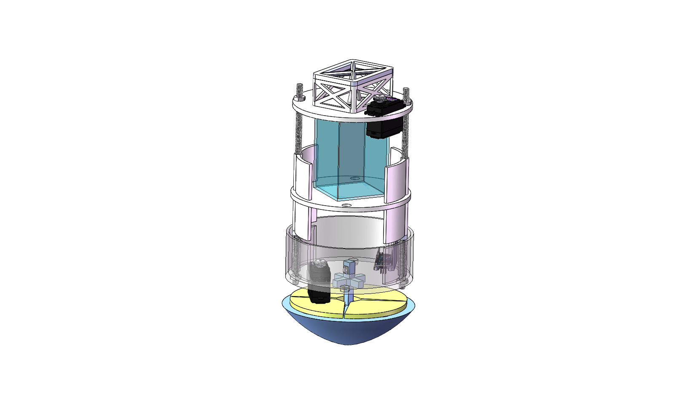
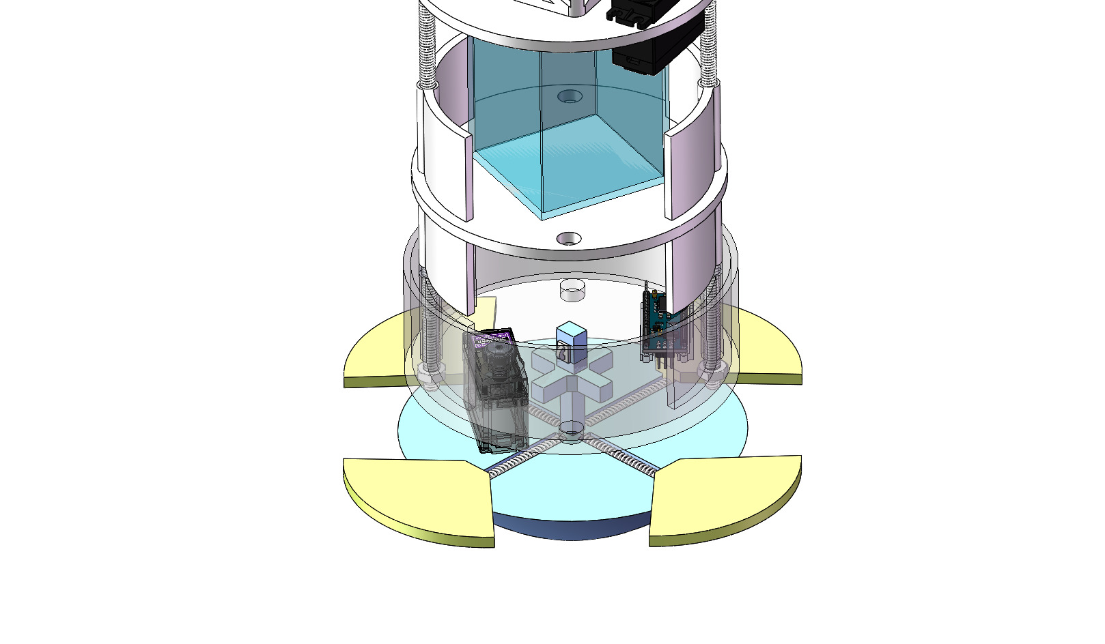
System Level CanSat Configuration Trade & Selection (2/2)
System Design 2
Parachute encasing
Rope guide for parachute attachment
Servo motor for parachute release
Dual threaded rod support beams
Rectangular egg capsule
Support encasing for mounting electronics
Servo motor for heatshield detachment
Spring loaded heatshield
Nose cone
Activated heatshield
Presenter: Samuel Taylor

Slide 17
System Level Configuration Selection
Chosen Design: System 1
Configuration | Reasoning
Rotating heatshield | Provides consistent and powerful deployment. In addition, the outward rotation creates an aerodynamic shape that will benefit stability on the decent. The combination of heat shield and nose cone allow for a simple detachment.
Suspended oval shaped egg capsule | The oval shape minimizes the material being used while protecting the egg in the places that matter. The suspension allows for some shock resistance from unexpected forces, thus providing better all-around protection.
Linear actuator for heatshield detachment | Keeps detachment simple without weakening the structural integrity of the CanSat. Due to the mechanism being active we can confirm the heatshield will detach.
Presenter: Jake Edwards

Slide 18
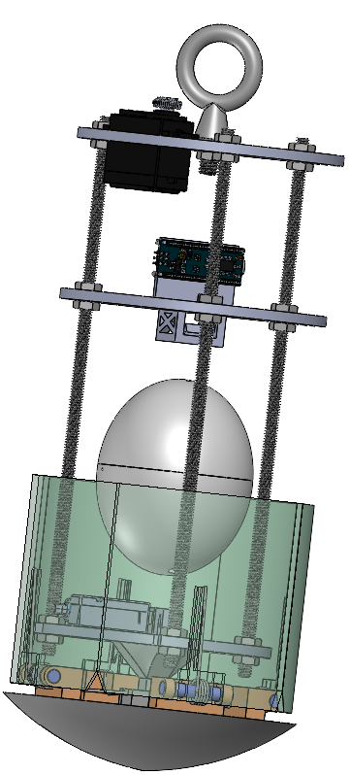
Physical Layout
5
Red: Parachute Deployment
Blue: Avionics Bay
Yellow: Egg Protection Bay
Pink: Heat Shield and Deployment
4
Basic Dimensions
1: Shoulder Width - 136 mm
2: Nose Cone Diameter - 142 mm
3: Shoulder Length - 100 mm
4: 267.4 mm
5: 300 mm
Heat shield deployed configuration. Red lines represent where mylar fabric will be. Section in the back is omitted for simplicity.
Servo Motor for parachute deployment
3
Rubber band attachment
Linear actuator for heat shield detachment
Hinge for heat shield
Nose Cone
1
2
Total Mass 895.73 g
Presenter: Jake Edwards

Slide 19
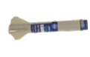
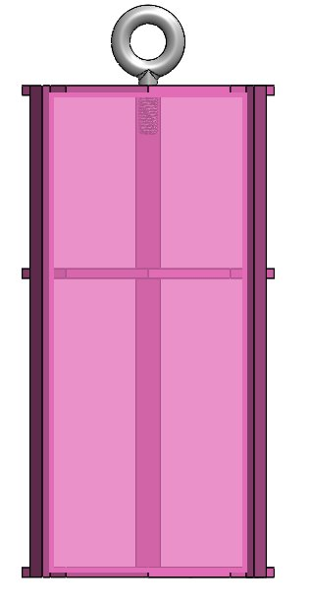

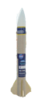
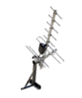


System Concept of Operations
6
Set up ground station.
Power on CanSat.
Egg is placed inside compartment and loaded into CanSat.
Place CanSat into rocket.
Rocket is launched.
At maximum altitude of 725 m, CanSat is ejected from the rocket the heat shield is immediately deployed and aerobraking starts. Descent is slowed to 10-30 m/s.
At 100 m heat shield/aerobrake is detached and the parachute is deployed decreasing the descent to <5 m/s.
CanSat will land upright.
Recovery crew tracks and collects CanSat and intact egg.
FSW obtains and saves flight data & video recording thumb drive.
7
5
8
4
9
2
3
1
10
Presenter: Zachary DeFabrizio

Slide 20
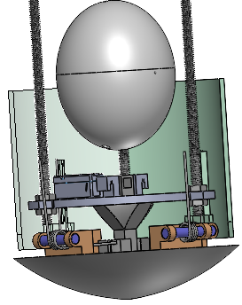
Launch Vehicle Compatibility
Sharp protrusions and corners will be sanded down.
74.79 mm
105.3 mm
110.0 mm
136.0 mm
142.0 mm
Presenter: Jake Edwards

Slide 21
Sensor Subsystem Design
Jonathan (Yoni) Gutmann

Slide 22
Sensor Subsystem Overview
Sensor Type​ | Model​ | Purpose​ | CanSat Location​
GPS module​ | Adafruit Ultimate | Determine location coordinates (X,Y,Z) & exact time | ​Payload
Pressure Sensor​ | Adafruit BMP280 | Measure altitude of Container & Payload | Payload
Rotational Sensor | BNO055 | Measure gyro readings in degrees per second, angular acceleration, and magnetometer readings in gauss | ​Payload
Temperature Sensor | Adafruit BMP280 | Measure temperature readings | Payload
Camera​ | ESP-32 | View and record Earth’s terrain during descendent | Payload
Wind Speed Sensor | PX4 | Measure air speed differential | Payload
Presenter: Jonathan (Yoni) Gutmann

Slide 23
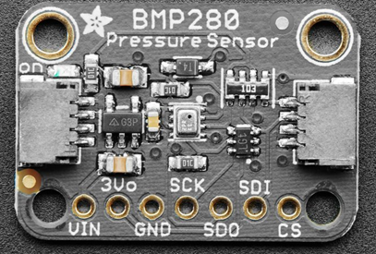
Payload Air Pressure Sensor Trade & Selection
Sensors​ | Current (at 1Hz) (µA)​ | Temperature Range (°C)​ | Interfaces​ | Resolution (hPa)​ | Voltage Usage (V)​ | Size (mm)​ L x W x H​ | Weight (g)​ | Price ($)​
Adafruit MPRLS​ | 3.6​ | -40 to 85​ | I2C, SPI​ | .30 | 1.65 ~ 3.6​ | 17.8 x 16.7 x​ 7.5​ | 1.1 | 14.95​
Adafruit BMP280​ | 2.7​ | -40 to 85​ | I2C, SPI​ | .0016 | 1.71 ~ 3.6​ | 19.2 x 17.9 x 2.9 | 1.3​ | 9.95​
MPL3115A2 | 8.5 | -40 to 85 | I2C | .015 | 1.95~ 3.6 | 18 x 19 x 2 | 1.2 | 9.95
Selection​ | Reasoning for the selection​
Adafruit BMP280​ | - Lower current draw in comparison to other inspected sensors - Greater resolution in comparison to other inspected sensors - Previous familiarity with the sensor - Also satisfies as our temperature sensor
Presenter: Jonathan (Yoni) Gutmann

Slide 24
Payload Air Temperature Sensor Trade & Selection
Sensors​ | Current (at 1Hz) (µA)​ | Temperature Range (°C)​ | Interfaces​ | Resolution (hPa)​ | Voltage Usage (V)​ | Size (mm)​ L x W x H​ | Weight (g)​ | Price ($)​
Adafruit MPRLS​ | 3.6​ | -40 to 85​ | I2C, SPI​ | .30 | 1.65 ~ 3.6​ | 17.8 x 16.7 x​ 7.5​ | 1.1 | 14.95​
Adafruit BMP280​ | 2.7​ | -40 to 85​ | I2C, SPI​ | .0016 | 1.71 ~ 3.6​ | 19.2 x 17.9 x 2.9 | 1.3​ | 9.95​
MPL3115A2 | 8.5 | -40 to 85 | I2C | .015 | 1.95~ 3.6 | 18 x 19 x 2 | 1.2 | 9.95
Selection​ | Reasoning for the selection​
Adafruit BMP280​ | - Lower current draw in comparison to other inspected sensors - Greater resolution in comparison to other inspected sensors - Previous familiarity with the sensor - Also satisfies as our pressure sensor
Presenter: Jonathan (Yoni) Gutmann

Slide 25
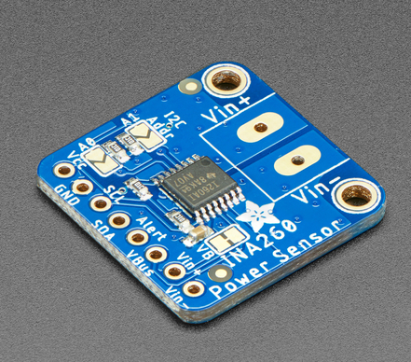
Payload Battery Voltage Sensor Trade & Selection
Sensors​ | Resolution | Interfaces | Size (mm)​ L x W x H​ | Weight (g)​ | Price ($)​
Adafruit INA219 | 12 bit | I2C | 25.6 x 20.4 x 4.7 | 4.6 | 9.95​
Adafruit INA260 | 16 bit | I2C | 22.9 x 22.8 x 2.7 | 2 | 9.95​
Precision LM4040 | 12 bit | I2C | 16 x 12.5 x 2.5 | 0.7 | 7.50
Selection​ | Reasoning for the selection​
Adafruit INA260 | - Greater resolution bit compared to other sensors - Previous experience and familiarity with sensor - Availability
Presenter: Jonathan (Yoni) Gutmann

Slide 26
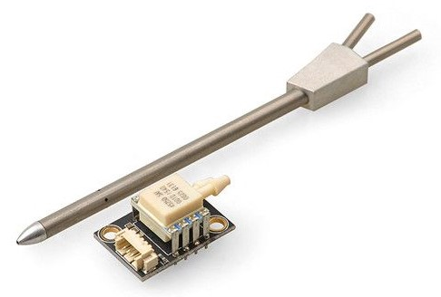
Payload Speed Sensor Trade & Selection
Sensors​ | Resolution | Interfaces | Size (mm)​ L x W x H​ | Weight (g)​ | Price ($)​
PX4 Differential Air Speed | 12 bit | I2C | 100x15 | 16 | 55.88
PT60 | 12 bit | I2C | 110 x 9.8 | 14.1 | 48.99
Selection​ | Reasoning for the selection​
PX4 Differential Air Speed | - More advantageous regarding budget - Microcontroller friendly - Speedy shipping
Presenter: Jonathan (Yoni) Gutmann

Slide 27
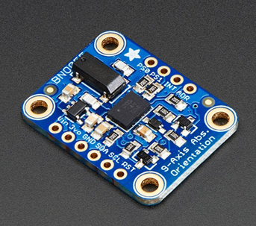
Payload Tilt Sensor Trade & Selection
Sensors​ | Temperature Range (°C)​ | Interfaces​ | Voltage Usage (V)​ | Size (mm)​ L x W x H​ | Weight (g)​ | Price ($)​
​HTU31 Temperature & Humidity Sensor | -40 to 125 | I2C​ | 3.3 – 5.5 | 25.5 x 17.7 x​ 4.6 | 1.6​ | 6.95​
BNO055 | -40 to 85​ | I2C or UART | 1.7 – 3.6 | 20 x 27 x 4 | 3 | 34.95
Sensirion SHT31-D | -40 to 125 | I2C​ | 2.4 – 5.5 | 12.7 x 18 x 2.6 | 0.8​ | 13.95​
Selection​ | Reasoning for the selection​
BNO 055 | - Familiarity with sensor - Compatibility with microcontroller - Availability
Presenter: Jonathan (Yoni) Gutmann

Slide 28
Rotation Sensor Trade & Selection
Sensors​ | Temperature Range (°C)​ | Interfaces​ | Voltage Usage (V)​ | Size (mm)​ L x W x H​ | Weight (g)​ | Price ($)​
​HTU31 Temperature & Humidity Sensor | -40 to 125 | I2C​ | 3.3 – 5.5 | 25.5 x 17.7 x​ 4.6 | 1.6​ | 6.95​
BNO055 | -40 to 85​ | I2C or UART | 1.7 – 3.6 | 20 x 27 x 4 | 3 | 34.95
Sensirion SHT31-D | -40 to 125 | I2C​ | 2.4 – 5.5 | 12.7 x 18 x 2.6 | 0.8​ | 13.95​
Selection​ | Reasoning for the selection​
BNO 055 | - Familiarity with sensor - Compatibility with microcontroller - Availability - Also used as tilt sensor
Presenter: Jonathan (Yoni) Gutmann

Slide 29
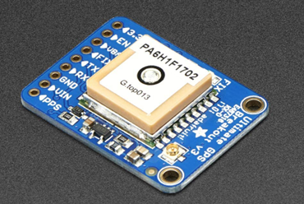
Payload GPS Sensor Trade & Selection
Sensors​ | Update Rate (Hz) | Operating Voltage (V)​ | Current (Tracking) (mA) | Interfaces | Size (mm)​ L x W x H​ | Weight (g)​ | Price ($)​
Adafruit Ultimate Breakout v3​ | 10​ | 3.0 – 5.0 | 20 | I2C, SPI, UART | 25.5 x 35 x 6.5 | 8.5 | 29.95​
uBlox NEO M8N | 10​ | 2.7 – 3.6 | 23 | I2C, SPI, UART | 27.6 x 26.6 x 2.4 | 9.8​ | 11.59​
Titan X1 | 10 | 3.0 – 4.3 | 25 | I2C, SPI, UART | 12.5 x 12.5 6.5 | 4 | 69.84
Selection​ | Reasoning for the selection​
Adafruit Ultimate | - Lower current draw during . tracking in comparison to other . inspected sensors - Previous experience with sensor . and familiarity with Arduino - Availability
Presenter: Jonathan (Yoni) Gutmann

Slide 30
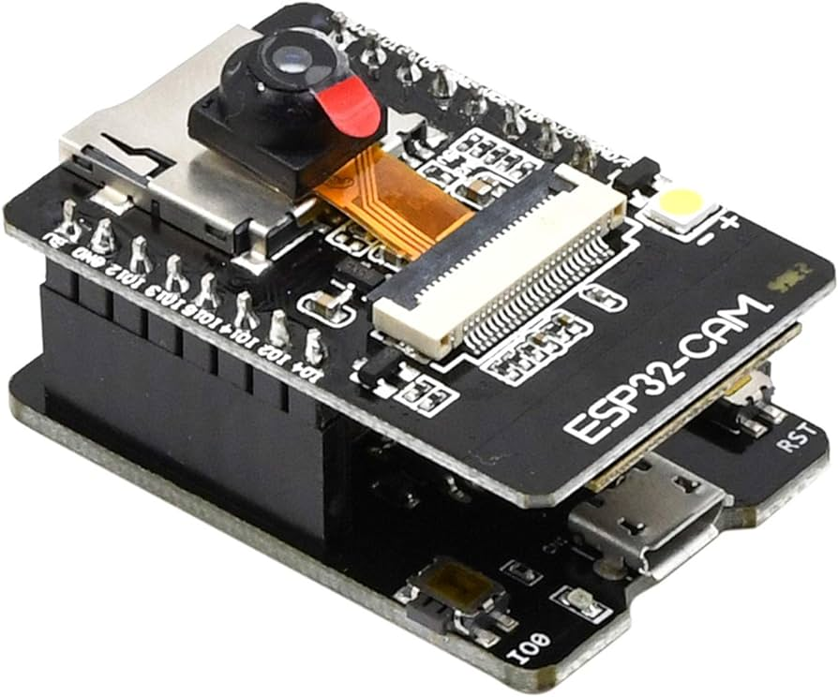
Payload Camera Trade & Selection
Name ​​ | Price ($) ​​ | Weight (g)​​ | Size (mm)​​ | Operating​​ Voltage (V) ​​ | Current Draw (mA) | Framerate (fps)​
Miniature TTL Serial JPEG Camera | 34.95​ | 3​ | 20 x 28 | 3.3 - 5.0​ | 75 | 30​
Arducam Mini 2MP Plus | 25.99 | 20 | 24 x 34 | 3.3 - 5.0 | 20 | 15
ESP-32 | 18.49 | 28 | 90 x 55 x 37 | 4.75V-5.25V | 310 | 30
Selection​ | Reasoning for the selection​
ESP-32 | - Meets recording specifications - Readily available - SD card slot is built-in and video storage is easily configurable
Presenter: Jonathan (Yoni) Gutmann

Slide 31
Bonus Camera Trade and Selection
The bonus is not being attempted
Presenter: Jonathan (Yoni) Gutmann

Slide 32
Descent Control Design
Melanie Miguel, Jake Edwards, Samuel Taylor, Zachary DeFabrizio, Christian Roque

Slide 33
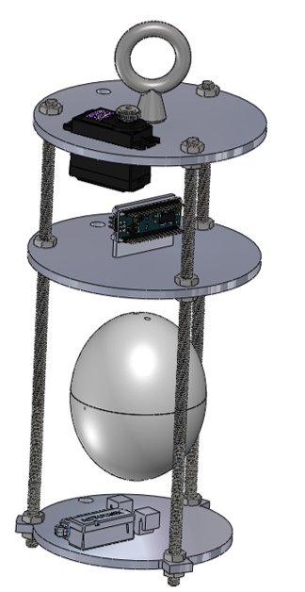
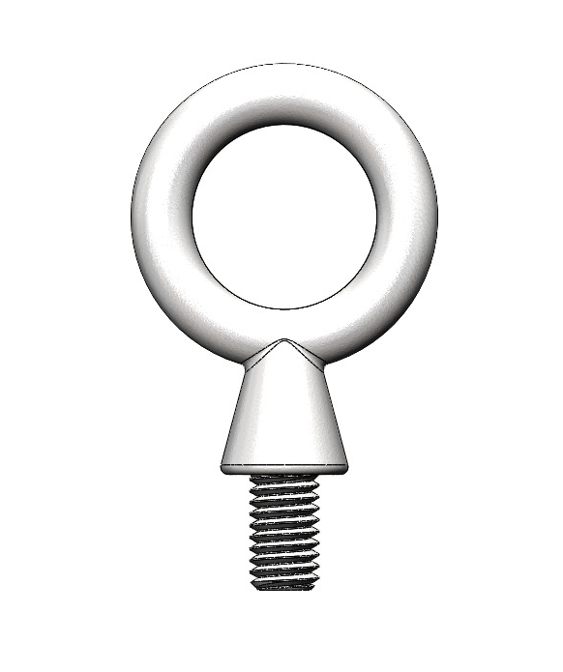
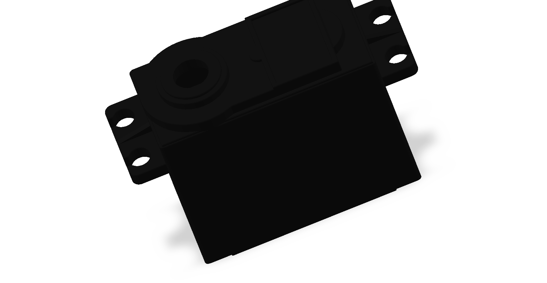
Descent Control Overview
Container Descent Control System:
System: Aerobraking Heat Shield, Parachute
System Components:
Fiberglass eyebolt
TARC Hexagonal Parachute
with Spill Hole
Nylon Parachute Chords
Servo Motor
System Overview: An eyebolt is attached to the base of the nose cone on a section separating the parachute system from the other nosecone components. The parachute will stay on top of the plate tied tightly to the eyebolt. A string holds the parachute together, against the plate and is looped off the side to the end of the servo motor. The servo is attached to the opposite side of the plate. When the desired altitude is achieved, the servo will retract forcing the string to release along with the parachute.
Nose cone and heatshield are deployed
Parachute deploys and heat shield detaches @ 100m
Payload lands secured
Presenter: Melanie Miguel

Slide 34
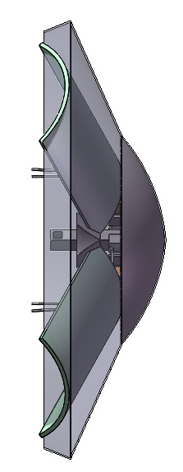
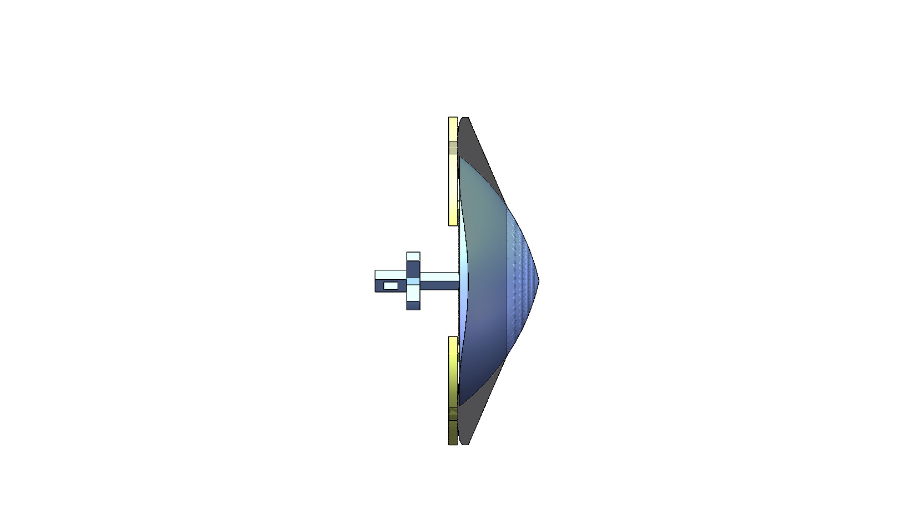
Payload Aerobraking Descent Control Strategy Selection and Trade (1/2)
 | Design 1 | Design 2
Encasing | Mylar | Mylar
Shape | Rounded Cone Circular Cross-Sectional Shape | Pointed Cone Circular Cross-Sectional Shape
Size | Base Diameter of 300 mm Area: ~ 18,250mm^2 | Base Diameter of 213 mm Area: ~ 6350mm^2
Angles | ~ 25° | ~ 25°
Cost | $7.72 for springs $15.77 for ABS | $5.55 for springs $15 for ABS
Design 1
Design 2
142 mm
213 mm
300 mm
Presenter: Samuel Taylor

Slide 35
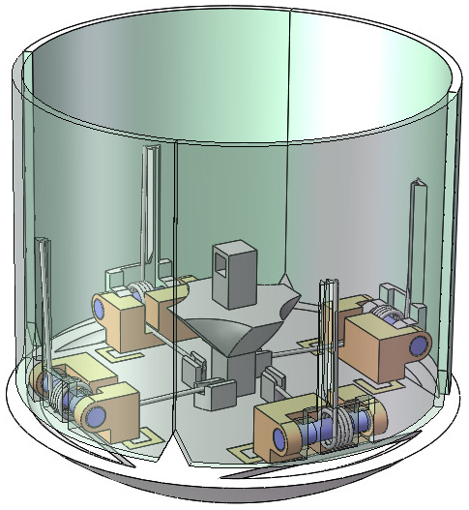
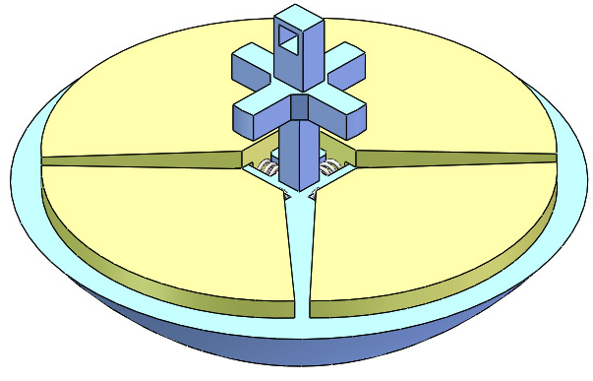
Payload Aerobraking Descent Control Strategy Selection and Trade (2/2)
Design | Description | Identified Issues | Evaluation
Torsion Hinge Shield | Following deployment from the can, torsion springs will rotate the shield toward the nose creating a larger cone shaped nose. The increased surface area of the nose cone will slow descent. | Design is heavier then preferred. Assembly and repairs are difficult. | Selected, allows for necessary deceleration while minimizing the size of the nose cone.
Spring Loaded Shield | Following deployment from the can, linear springs extend semi-circular plates that increase the noses area. The increased surface area will slow descent. | Design requires a larger then preferred nose cone. Smooth extension proved difficult to be inconsistent. | Discarded
Configuration A: Torsion Hinge Shield
Configuration B: Spring Loaded Shield
Presenter: Samuel Taylor

Slide 36
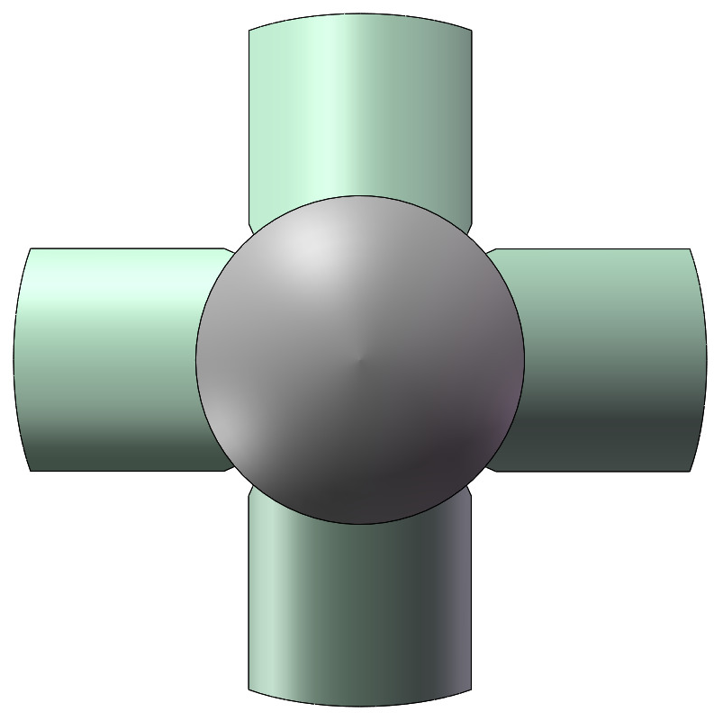
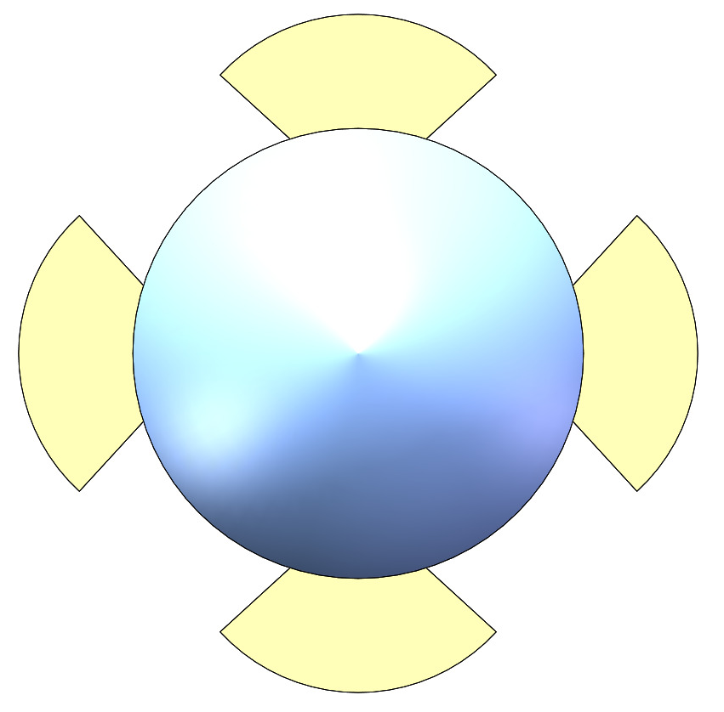
Payload Aerobraking Descent Stability Control Strategy Selection and Trade
Method | Description | Identified Issues | Evaluation
Torsion Hinge Shield | The hinged shields will open creating an elongated rounded cone shape. The shields can adjust their angle in accordance with wind patterns increasing decent stability | When air resistance is very strong, the shields may not be able to open to their full potential. May take a few seconds to get to full potential. | Selected, the variable angle of the heatshield allows for more stability throughout descent.
Spring Loaded Shield | The linear shields will open creating a small pointed cone shape. The larger aerodynamic shape will increase stability. | The stiff position of the open shield is vulnerable to uneven air currents. | Discarded
Configuration A: Torsion Hinge Shield
Configuration B: Spring Loaded Shield
Presenter: Samuel Taylor

Slide 37
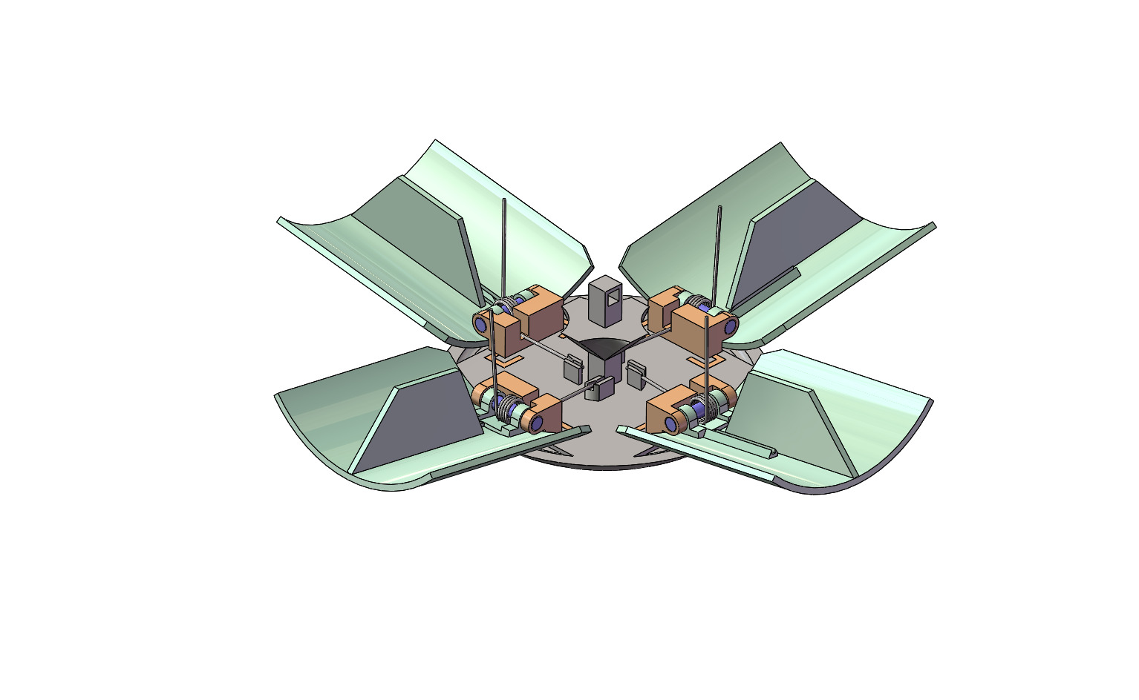
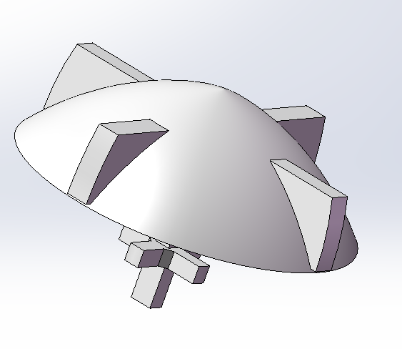
Payload Rotation Control Strategy Selection and Trade
Fins
Configuration A: Hinge Spring Fins
Configuration B: Nose Cone Control
Design | Description | Identified Issues | Evaluation
Hinge spring fins | Interior fins on spring-loaded flaps deploy with the heat shield, ensuring Z-axis stability during CanSat’s descent | Reduces interior space Increased weight of the overall design | Selected, allows for necessary control of Z-axis rotation
Nose cone control | Fins on the nose cone ensure Z-axis stability during the CanSat’s ascent and descent not allowing for a large range of rotation around the z axis | Increase the complexity of the print Reduces size of egg container | Discarded
Presenter: Zachary DeFabrizio

Slide 38
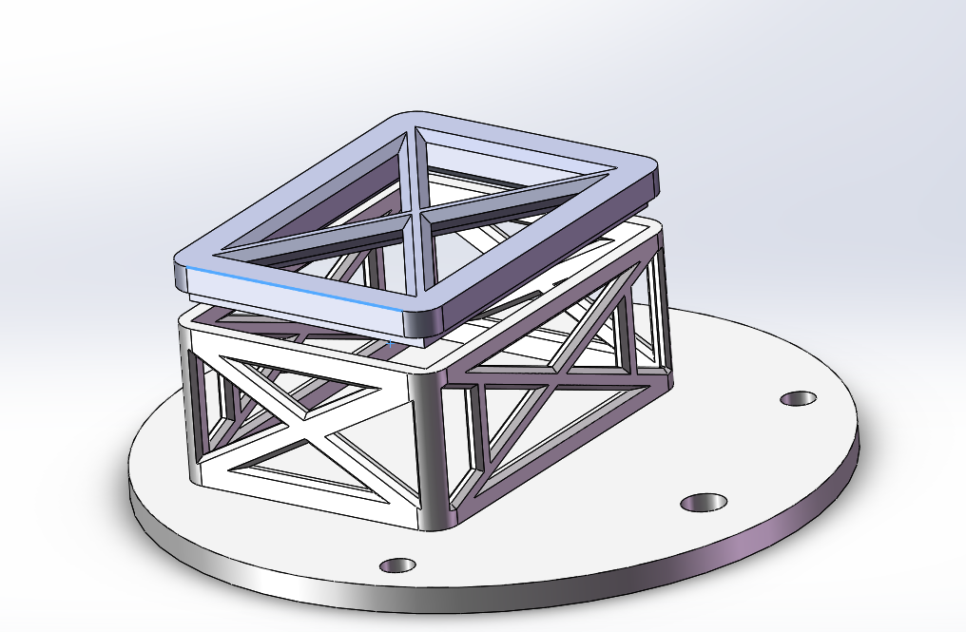
Payload Parachute Descent Control Strategy Selection and Trade
Method | Description | Identified Issues | Evaluation
Separate Container with Hatch System | A container attached to the beams of the nosecone would hold the parachute and allow for its release | The addition of a container adds weight in addition with a battery needed which increases costs. Manufacturing and implementation is more complicated. | Discarded
Resting of base of nosecone | The parachute will rest on top of a plate separate from the rest of the nosecone components and will be tied down. Attached on the opposite side will be a servo motor that hold the string. When the desired altitude of 100 meters is reached, the rotational device will spin to release the string allowing the parachute to be released. | Relying on string to hold the parachute, some weight added with servo motor | Selected, can be secured and implemented correctly and servo motors are easily obtainable
Option A:
Option B:
Parachute lies on top plate
Presenter: Melanie Miguel

Slide 39
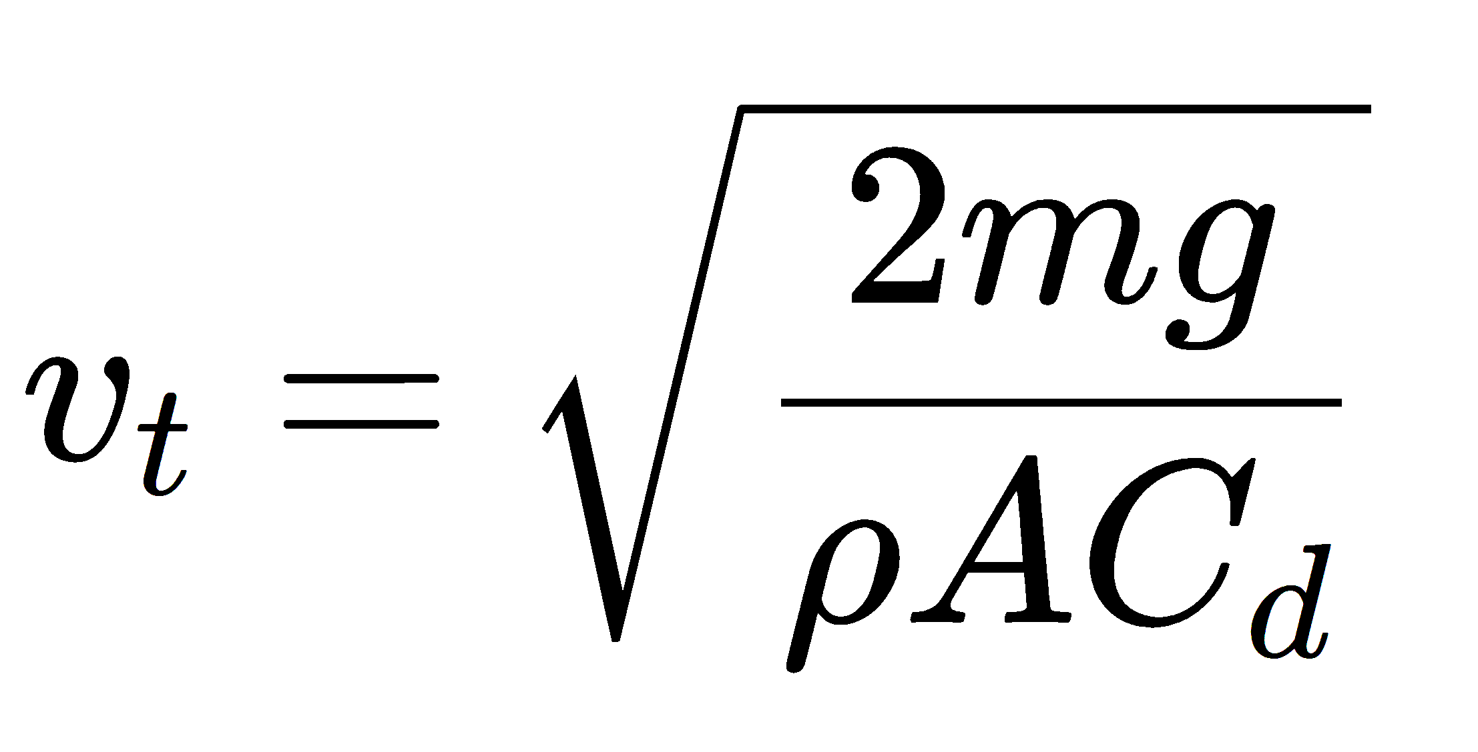
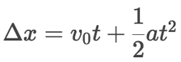
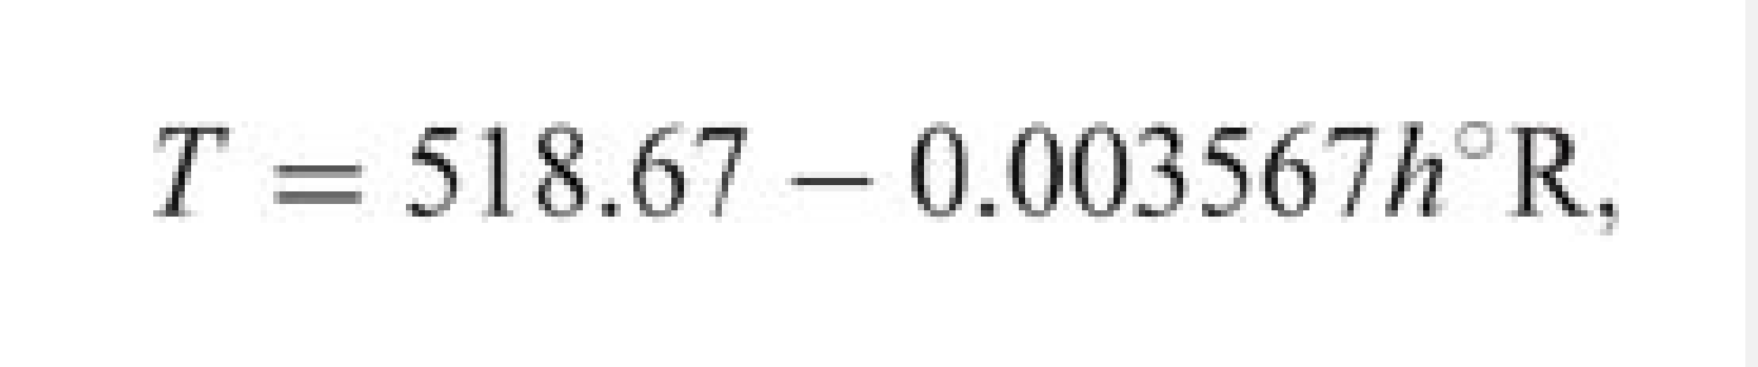
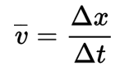
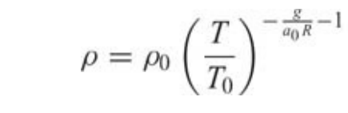
Descent Rate Estimates (1/2)
Discussion
Drag coefficient of parachute based on information provided by the vendor and heatshield drag coefficient determined through research
According to calculations, once the heatshield is at terminal velocity, it’s arms should form no less than a 45˚ half-vertex angle
Weight of the nosecone may vary if further drop testing shows that a lower center of mass is required.
All parameters used are to simulate maximum and harshest conditions
ε = half-vertex angle
ε
Formulas Used:
Presenter: Christian Roque

Slide 40
Descent Rate Estimates (2/2)
Decent Rate Estimates for the following Configurations
Assumptions
Heatshield weight is 377.2 grams
Total weight is 975 grams or less
Cd ≈ 0.75 of a 3D cone with 45˚ half vertex
Standard atmospheric model used
Estimated altitude range: 634m – 1359m
Estimated air density range: 1.03588kg/m^3 - 1.11308 kg/m^3
Estimated air density @ 100m above ground = 1.10219 kg/m^3
Configuration | Device | Desired Rate | Decent Rate Estimate | Method of Calculation
Payload with heatshield | Aerobraking | 10 m/s - 30 m/s | < 17.432 m/s | Terminal velocity calculations
Payload without heatshield | Parachute | Less than 5 m/s | < 4.129 m/s | Parachute calculations
Heatshield only | Aerobraking | Less than 10 m/s | < 9.760 m/s | Terminal velocity calculations
Presenter: Christian Roque

Slide 41
Mechanical Subsystem Design
Zachary DeFabrizio, Jake Edwards, Melissa Gonzalez, Jonathan (Yoni) Gutmann, Melanie Miguel, Christian Roque, Samuel Taylor

Slide 42
Mechanical Subsystem Overview
Servo Motor:
Attached to a nylon cord that holds the parachute to the CanSat. Can be activated to release the parachute.
Parachute Attachment:
A threaded fiberglass eyebolt that provides a physical attachment from the CanSat to the parachute.
Aluminum threaded rod:
Threaded rods that provide structural integrity along with layer adjustments.
Oval shaped egg capsule:
An ABS container that encapsulates the egg. Suspended from the bottom and middle platform with elastic bands as shock resistance.
ABS platforms:
Circular ABS platforms that allow for placement of electronics and the mounting of the egg capsule.
Torsion Hinged Heatshield:
Four ABS shields rest inside the shoulder of the rocket before separation. After separation, torsion springs open rotating the shields outward increasing the drag force on the CanSat.
Linear Actuator:
Attaches the Heatshield to the rest of the CanSat when deployed. Can be retracted to release heatshield at desired altitude.
Presenter: Samuel Taylor

Slide 43
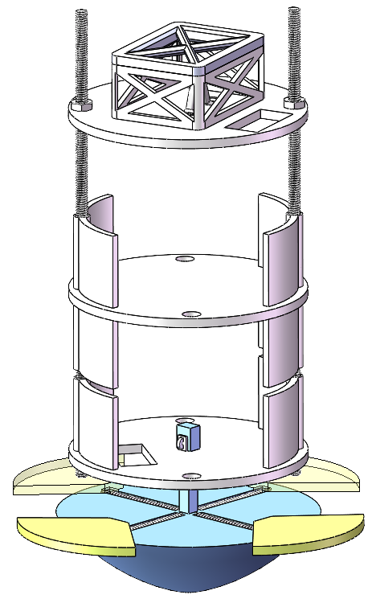
Payload Mechanical Layout of Components Trade & Selection (1/2)
Parachute Attachment
Nuts
Threaded Poles
Parachute Attachment
Plates
Horizontal Springs
Heat Shield Flaps (Nose Cone included in full heat shield)
Nose Cone
Design​ | Description​ | Materials​ | Evaluation​
Spring Loaded Shield | Compressed cylindrical shape. Heat shield spring loaded by horizontal springs. When released the heat shield deploys horizontally to its lengthened position. Heat shield held in place by plastic rod. A series of plastic sections structured by threaded aluminum rods. First there is a section for the electronics, followed by a section for the egg and parachute. | Plates – ABS Plastic​ Threaded Poles – Aluminum Nuts – Aluminum Heat Shield – ABS Plastic​ Horizontal Springs –Aluminum Parachute Attachment – Steel ​Nose Cone – ABS Plastic Electronic Mounts – ABS Plastic ​ ​ | Discarded
Presenter: Jake Edwards

Slide 44
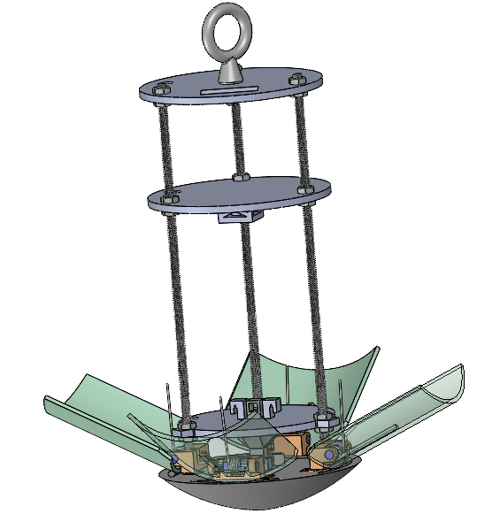
Payload Mechanical Layout of Components Trade & Selection (2/2)
Parachute Eye Bolt
Plates
Nuts
Torsion Springs
Threaded Poles
Hinge
Heat Shield Flaps (Nose Cone included in full heat shield)
Nose Cone
Design​ | Description​ | Materials​ | Evaluation​
Torsion Hinge Shield | Compressed cylindrical shape. Heat shield is spring loaded with torsion springs to 90 degrees when inside of the rocket. When released the springs move to their relaxed position of 180 degrees deploying the heat shield, guided by hinges. The heat shield is held to the payload by plastic rod. There are is then a section divided by circular plastic plates reserved for the egg protection followed by a section reserved for electronics and parachute. Sections structured by threaded aluminum rods. | Plates – ABS Plastic​ Threaded Poles – Aluminum Nuts - Aluminum​ Heat Shield Flaps– ABS Plastic​ Torsion Springs –Aluminum Parachute Eye Bolt – Steel Hinges – ABS Plastic​ ​Nose Cone – ABS Plastic ​ ​ | Selected, more structurally sound, more stable heat shield, more efficient aerobraking​
Presenter: Jake Edwards

Slide 45
Payload Aerobraking Pre Deployment Configuration Trade & Selection
Spring deployment location
Configuration | Advantages | Disadvantages | Evaluation
Umbrella loaded Spring Deploy | Interchangeable parts Larger spring load to hold the load in place Acts as an additional layer of containment for the egg | Heavier Increased in complexity, meaning a higher chance of failure Higher cost because of springs | Selected, Sturdier, while also providing additional protection to egg
Horizontal loaded Spring | Easier to manufacture Occupies smaller section of the CanSat Lighter weight Cost efficient | Not able to hold the CanSat in place as effectively Not as sturdy and able to resist force create by drag Does not add more protection to the egg on lift-off | Discarded
Presenter: Zachary DeFabrizio

Slide 46
Payload Aerobraking Deployment
Configuration Trade & Selection
Nose cone is considered a part of the heat shield and aerobraking
Mylar heat shield fabric attachment shown in red
Horizontal Spring Deploy
Umbrella Spring Deploy
Configuration​ | Method​ | Identified Issues​ | Evaluation​
Spring Loaded Shield | Upon release from can, the spring-loaded arms will be expanded horizontally, causing the implementation of the heat shield which acts as the aerobraking device. | Inefficient aerobraking. Unstable heatshield due to the small diameter. Uses more internal space. | Discarded
Torsion Hinge Shield | Upon release from can, loaded torsion springs will extend to their relaxed 180-degree position, pivoting though the hinges. With the connected mylar fabric this causes the implementation of the heat shield which acts as the aerobraking device. | Harder to manufacture. More spring strength needed because of the angular motion. | Selected, design allows for a larger heat shield and efficient aerobraking. Designing shield down the rocket saves space inside.
Presenter: Jake Edwards

Slide 47
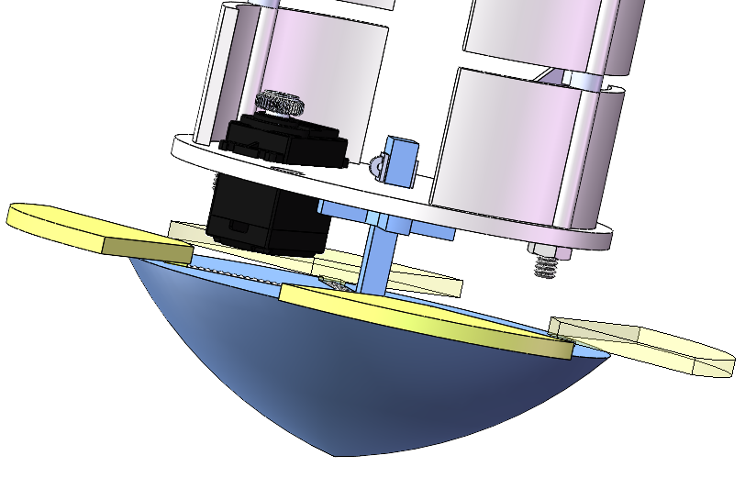
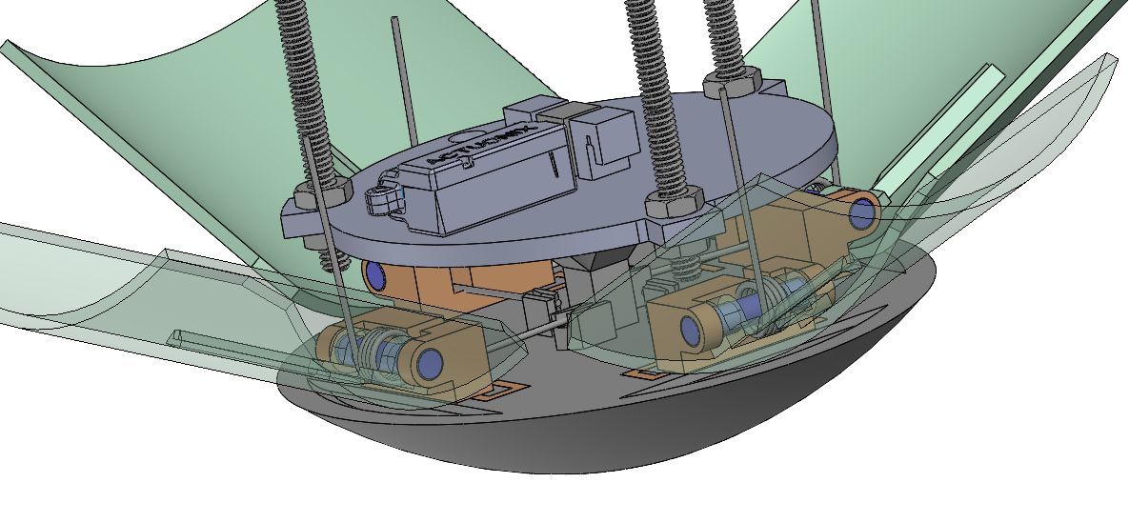
Payload Aerobraking Release Trade & Selection
Servo
Linear Actuator
Piston
Actuator entry
Cross Supports
Cross Supports
Horizontal Spring Deploy
Umbrella Spring Deploy
Configuration​ | Method​ | Identified Issues​ | Evaluation​
Servo Motor Release | There is a piston through the square rod ​in the payload. When prompted the servo motor rotates and pulls a cord that pulls the piston freeing the heat shield module. The cross supports take weight off piston. | Latency in the deployment time. String would allow for unwanted rotation. Added mass. | Discarded​
Linear Actuator Release | The square rod through the payload contains a hole for a linear actuator rod. When prompted the linear actuator retracts and the heat shield is released. The square rod and linear actuator restrict rotation and vertical motion. The cross supports take weight off linear actuator. | Linear actuator cannot take a great load. Rotation could lead to actuator stress. | Selected, provides further stability and control over time of release.
Presenter: Jake Edwards

Slide 48
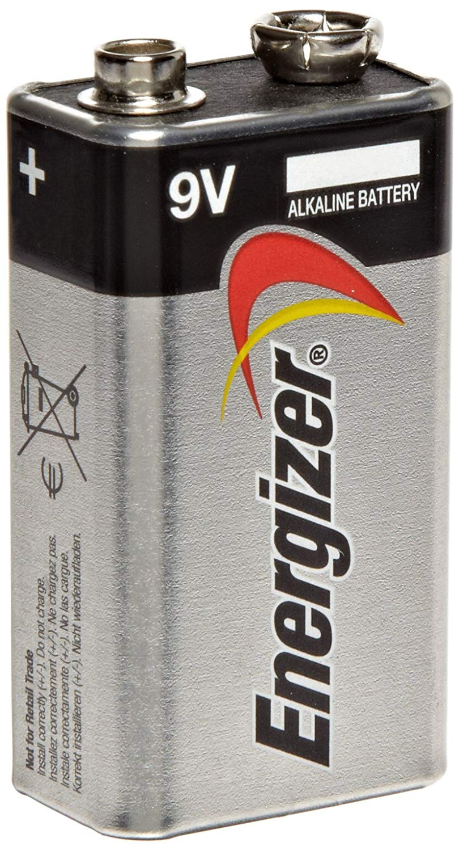
Payload Parachute Deployment
Configuration Trade & Selection
Method | Description | Identified Issues | Evaluation
Latch top and hatch | A latched container would hold the parachute and released when a battery powered a latch to release. | Adds significant weight and costs increased with additional section of nosecone. Battery necessary also increases both factors significantly. | Discarded
Servo Motor release | A servo motor is hooked onto a string that wrapped around the extended portion. This string also ties the parachute together. Once retracted at desired altitude, the string is released along with the parachute. | Additional cost for servo motor and structure to ensure string is not released too early. | Selected, costs are reduced, and mechanism is fairly easy to implement
Option A:
Option B:
Presenter: Melanie Miguel

Slide 49
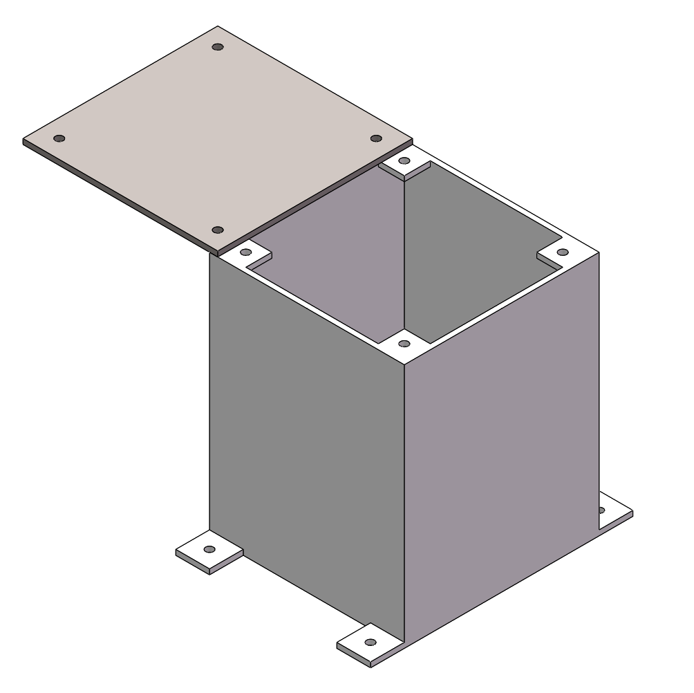
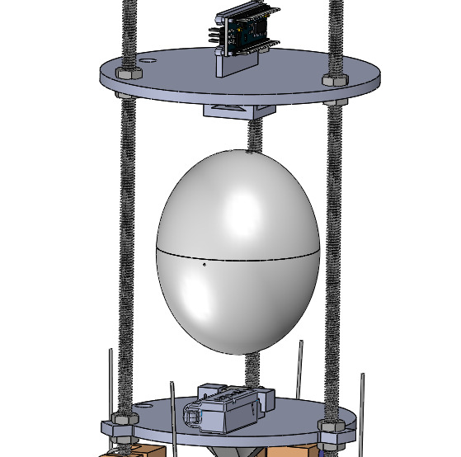
Payload Egg Containment
Configuration Trade & Selection
Box stuffed with foam
Easter Egg stuffed with foam encapsulates egg
Elastic bands stretched between egg and frame
Screw holes threaded to CanSat frame
Configuration​ | Method​ | Identified Issues​ | Evaluation​
Simple box with foam | Simple rectangular box is stuffed with shock absorbent foam, egg is placed in box and then screwed to CanSat frame. | Far too rigid and provides un-even protection from shock. Long installation time required for inserting screws. | Discarded​
"Easter egg“ shape container with foam | The container is stuffed with memory foam, egg is placed inside, contraption is closed with screws, and then suspended using stretched elastic bands between the egg and frame of CanSat. | Elastic bands could be difficult to attach quickly and evenly to frame. | Selected, provides omnidirectionality and reliability against uncertain flight paths
Presenter: Christian Roque

Slide 50
Electronics Structural Integrity
Electronic component mounting methods:
Standoffs and screws, high-performance adhesive.
Electronic component enclosures:
All components will be within the payload.
Securing electrical connections:
All components will be soldered, with heat shrink tubing used at wire junctions.
Wires will be kept from moving by tape or glue if necessary.
Descent control attachments
Motors/actuators will be mounted similarly to electronic components with screws and high-performance adhesive.
Presenter: Jonathan (Yoni) Gutmann

Slide 51
Mass Budget (1/3)
Component | Quantity | Weight (g) | Source
Eyebolt | 1 | 2.4 g | Estimate
Nut | 18 | 1 g (18 g total) | Estimate
Aluminum Rod | 3 | 16.78 g (50.34 g total) | Actual from Datasheet
Egg Container | 1 | 42.5 g | Actual from Datasheet
ABS Platforms | 3 | 185.09 g total | Estimate
Hinge | 4 | 10 g (40 g total) | Actual from Datasheet
Hinge Pin | 4 | 1 g (4 g total) | Actual from Datasheet
Torsion Spring | 4 | 4 g (16 g total) | Actual from Datasheet
Nose Cone | 1 | 140 g | Estimate
Heat Shield Plate | 4 | 54.3 g (217.2 g total) | Actual from Datasheet
Parachute | 1 | 34 g | Actual from Datasheet
Presenter: Melissa Gonzalez

Slide 52
Mass Budget (2/3)
Component | Quantity | Weight (g) | Source
Standoffs | 4 | 0.5 g (2 g total) | Actual from Datasheet
High Performance Adhesive | 1 | 1 g | Estimate
Mylar | 1 | 2 g | Estimate
PCB Screws | 4 | 0.1 g (0.4 g total) | Actual from Datasheet
Elastic Bands | 2 | 1.5 g (3 g total) | Actual from Datasheet
Memory Foam | 1 | 5 g | Actual from Datasheet
Presenter: Melissa Gonzalez

Slide 53
Mass Budget (3/3)
Component | Quantity | Weight (g) | Source
Adafruit BMP280 | 1 | 1.3 g | Actual from Datasheet
Arduino Nano | 1 | 7 g | Actual​ from Datasheet
BNO-055 | 1 | 3 g | Actual​ from Datasheet
Adafruit Ultimate | 1 | 8.5 g | Actual​ from Datasheet
ANT-900-RP-2-A | 1 | 5 g | Estimate
XBEE Pro 900 Mhz Radio | 1 | 5 g | Actual from Datasheet
9 Volt Battery | 1 | 45 g | Actual from Datasheet
PX4 Pitot Tube | 1 | 16 g | Estimate
ESP-32 | 1 | 18 g | Actual from Datasheet
INA260 | 1 | 2 g | Actual from Datasheet
Servo Motor | 1 | 9 g | Actual from Datasheet
Linear Actuator | 1 | 15 g | Actual from Datasheet
Total Mass 895.73 g
Presenter: Melissa Gonzalez

Slide 54
Communication and Data Handling (CDH) Subsystem Design
Sanat Konda, Evan (Steele) Elliott

Slide 55
Payload Command Data Handler (CDH) Overview
Device Type​​ | Model​​ | Purpose​​
Processor & Memory​ | Arduino Nano | Facilitate data storage, sensing, communication​
Real-Time Clock​ | Adafruit Ultimate Breakout v3 GPS Module​ | Keep track of times for data & calculation purposes​
Antenna​ | ANT-900-RP-2-A | Transmit/receive data from radio/processor configuration​
Radio​ | XBEE-PRO 900HP | Communicate between antennae & processors​
Presenter: Sanat Konda

Slide 56
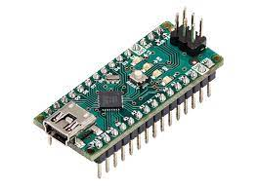
Payload Processor & Memory Trade & Selection
Processor | Boot time (s) | Speed (Mhz) | Memory (KB) | Weight (g) | Dimension (mm) | Voltage Input (V) | Ports
Arduino Nano​ | 8 - 10​ | 16​ | 32​ | 7​ | 18 x 45 ​ | 7 - 12​ | Analog Input - 8 PWM Output - 6 ​ I2C I/O - 1 ​ SPI - 1 ​ DAC Output - 0​
Raspberry pi Pico | 0.5 | 125 | 264 | 3 | 21 x 51.3 | 1.8 – 5.5 | Analog Input - 4 PWM Output - 8 I2C I/O – 1 SPI – 1 DAC Output - 1
​ Teensy 3.2​ ​ | 5​ | 16​ | 256​ | 4.8 | 18 x 36 | 5​ | Analog Input - 25 ​ PWM Output - 22 I2C I/O - 4 ​ SPI - 3 ​ DAC Output - 2​
Selection​ | Reasoning for selection​
​ Arduino Nano | - Compact size​ - Ease of use and familiarity​ - Availability
Presenter: Sanat Konda

Slide 57
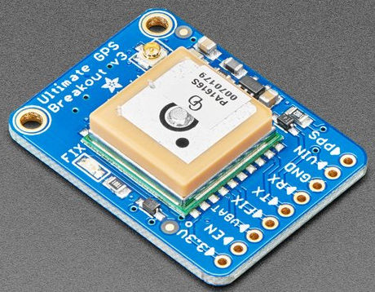
Payload Real-Time Clock
Real-Time Clock Keeper​ | Tolerance Reset​ | Interface | Cost ($)
Microchip MCP7940M-I/P | Real-Time clock continues keeping time in the event of a reset ​ | I2C | 0.75
Arduino Ultimate Breakout v3​ | Real-Time clock continues keeping time in the event of a reset ​ | Internal to GPS | 0.00
Selection​ | Reasoning for selection​
Adafruit Ultimate GPS Breakout | - Already part of the telemetry communications - Has an independent, onboard battery - No additional weight, size, or circuitry required
Presenter: Sanat Konda

Slide 58
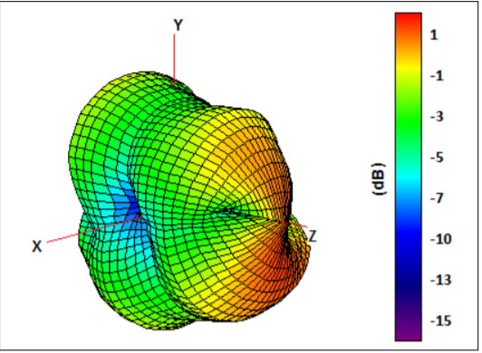
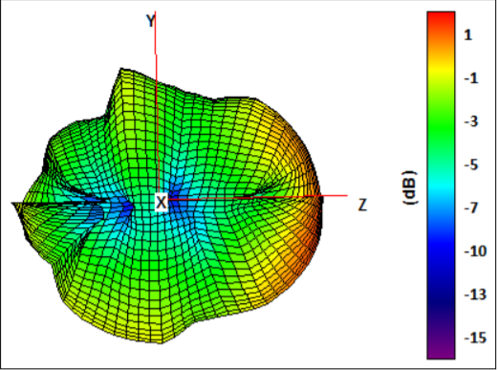
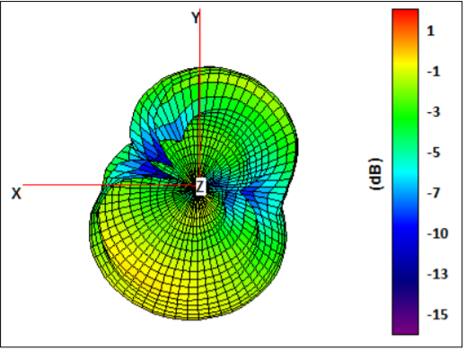
Payload Antenna Trade & Selection
Name​ | Frequency ​ Range (GHz)​ | Length of Antenna (mm)​ | Gain (dBi)​ | Polarization | Connection Type​ | Weight (g)
ANT-900-RP-2-A | ​ .880-.960 | 115 | 2​.1 | (Linear) Vertical | ​SMA​ | 11
Taoglas FXP290 915 MHz | .902-.928 | 100​ | ​1.5 | Linear | ​U.FL | 1.5
Selection​ | Reasoning for selection​
ANT-900-RP-2-A | - In accepted frequency range - Compatible with selected radio - Compact size
Presenter: Sanat Konda

Slide 59
Payload Radio Configuration
Name​ | Frequency ​ Range (GHz)​ | Outside Range (km) | Antenna Type​ | Weight (g) | Cost ($)
XBEE-PRO 900HP | .902 - .928 | 6.5​ | ​RPSMSA | 6.9 | 68
XBee S2C 802.15.4 | ​2.4 | 1.2​ | ​Wire | 5 | 30
Selection​ | Reasoning for selection​
XBEE-PRO 900HP | - Operates on accepted frequency - Excellent outside range - Previous familiarity and availability
Transmission Control​
- Data will be continuously sent at 1 Hz during all stages of flight - Transmission will be handled by FSW, starting on power on and ending once the container and payload have landed
NETID/PANID – 2031
Presenter: Sanat Konda

Slide 60
Payload Telemetry Format (1/3)
Transmitted Data will be saved to a .csv file on ground station.
Data Transmitted:
To GCS at 1 Hz packet transmission rate:
Payload sensor readings (Air pressure/temperature, mission time, GPS time, coordinates, power supply voltage, tilt, altitude, and various states)
How is data formatted?
-Payload-to-GCS:
TEAM_ID, MISSION_TIME, PACKET_COUNT, MODE, STATE, ALTITUDE, AIR_SPEED, HS_DEPLOYED, PC_DEPLOYED, TEMPERATURE, VOLTAGE, PRESSURE, GPS_TIME, GPS_ALTITUDE, GPS_LATITUDE, GPS_LONGITUDE, GPS_SATS, TILT_X, TILT_Y, ROT_Z, CMD_ECHO
Example:
2031, 23:35:59, 25, F, LAUNCH_WAIT, 150.2, 15.76, N, N, 25.3, 8.3,230, 13:35:35, 25, 150.0258, 168.6765, 58, 5.02, 3.05, 2.63, CXON
Presenter: Evan (Steele) Elliott

Slide 61
Payload Telemetry Format (2/3)
Telemetry Field | Purpose | Relayed From:
<TEAM_ID> | Team ID number (2031) | Payload
<MISSION_TIME> | UTC time from RST=0 in 1st software state (hh:mm:ss)
<PACKET_COUNT> | # of packets transmitted across all devices
<MODE> | 'F' = Flight (default) mode, 'S' = Simulation mode
<STATE> | Software State (STARTUP, DESCENT, etc.)
<ALTITUDE> | Altitude in meters relative to ground level (+/- 0.1 m)
<HS_DEPLOYED> | ‘P’ if the heat shield has been deployed, ‘N’ if not
<PC_DEPLOYED> | ‘C’ if the probe parachute has been deployed, ‘N’ if not
<AIR_SPEED> | Airspeed in meters per second measured with the pitot tube during both ascent and descent.
<TEMP> | The temperature in degrees Celsius (+/- 0.1C)
Presenter: Evan (Steele) Elliott

Slide 62
Payload Telemetry Format (3/3)
Telemetry Field | Purpose | Relayed From:
<PRESSURE> | The air pressure in kPa (+/- 0.1 kPa) | Payload
<VOLTAGE> | Voltage reading of Container power bus (+/- 0.1 V)
<GPS_TIME> | UTC time generated from GPS (hh:mm:ss) (+/- 1 sec)
<GPS_LATITUDE> | GPS latitude coordinate in decimal degrees (+/- 0.0001 degrees North)
<GPS_LONGITUDE> | GPS longitude coordinate in decimal degrees (+/- 0.0001 degrees West)
<GPS_ALTITUDE> | GPS altitude coordinate in decimal degrees (+/- 0.1 m from sea level)
<GPS_SATS> | # of satellites being tracked by GPS
<TILT_X> | The angle of the payload in the x direction in degrees (+/- 0.01)
<TILT_Y> | The angle of the payload in the y direction in degrees (+/- 0.01)
<CMD_ECHO> | The last command received and processed by the payload
<ROT_Z> | The rotation rate of the CanSat in degrees per second (+/- 0.1)
Presenter: Evan (Steele) Elliott

Slide 63
Payload Command Formats (1/2)
CX - Container Telemetry On/Off Command
CMD,<TEAM_ID>, CX, <ON_OFF>
CMD & CX | Static Text
<TEAM_ID> | Assigned Team Identification
<ON_OFF> | ON-activates Container transmissions OFF- turns off transmissions
Example: CMD,2031,CX,ON
ST - Set Time
CMD,<TEAM_ID>, ST, <UTC_TIME>
CMD & ST | Static Text
<TEAM_ID> | Assigned Team Identification
<UTC_TIME> | UTC time in the format hh:mm:ss
Example: CMD,2031,ST,13:35:59
SIMP - Simulated Pressure Data
CMD,<TEAM_ID>, SIMP, <PRESSURE>
CMD & SIMP | Static Text
<TEAM_ID> | Assigned Team Identification
<PRESSURE> | simulated atmospheric pressure data in units of pascals with a resolution of one Pascal.
Example: CMD,2031,SIMP,101325
SIM - Simulation Mode Control Command
CMD,<TEAM_ID>, SIM, <MODE>
CMD & SIM | Static Text
<TEAM_ID> | Assigned Team Identification
<MODE> | ‘ENABLE’ to enable -‘ACTIVATE’ to activate-'DISABLE’ both disables and deactivates -> simulation mode.
Example: CMD,2031,SIM,ACTIVATE
Presenter: Evan (Steele) Elliott

Slide 64
Payload Command Formats (2/2)
CAL – Calibrate Altitude to Zero
CMD,<TEAM_ID>, CAL
CMD & CAL | Static Text
<TEAM_ID> | Assigned Team Identification
Example: CMD,2031,CAL
BCN – Control Audio Beacon
CMD,<TEAM_ID>,BCN,ON|OFF
CMD & BCN | Static Text
<TEAM_ID> | Assigned Team Identification
ON|OFF | ON- turns on audio beacon OFF- turns off audio beacon
Example: CMD,2031,BCN,ON
Presenter: Evan (Steele) Elliott

Slide 65
Electrical Power Subsystem (EPS) Design
Jonathan (Yoni) Gutmann

Slide 66
EPS Overview
9V Battery
Switch
5V Regulator
3.3V Regulator
5V Bus
3.3V Bus
Presenter: Jonathan (Yoni) Gutmann

Slide 67
Payload Electrical Block Diagram
Power (9V Battery)
Switch
5V Regulator
3.3V Regulator
Raspberry Pi Pico (Powered by USB from Computer during Testing)
On/Off LED
IE92505 Speaker (5V)
PX4 Pitot Tube (5V, I2C)
BNO055 (5V, I2C)
ESP-32 (5V, I2C)
BMP280 (5V, SPI)
Adafruit Ultimate Breakout (5V, USART)
67
XBEE Pro 900HP (5V, SPI)
Presenter: Jonathan (Yoni) Gutmann

Slide 68
Payload Power Budget
Component​ | Voltage (V)​ | Power per Unit (W)​ | Duty Cycle (%)​ | Power Consumption (Wh)​ | Source
Raspberry Pi Pico (Microcontroller)​ | 9V​ | .1406​ | 100​ | 0.1406 | Datasheet
Adafruit Ultimate Breakout (GPS)​ | 5V​ | .1​ | 100​ | .1​ | Datasheet
BMP280​ (Air Temperature/Pressure)​ | 5V​ | 0.00025 | 100​ | 0.000025 | Datasheet
PX4 Differential Air Speed | 5V | 3.6 | 100 | 3.6 | Datasheet
Xbee Pro 900 HP​ (Radio Module)​ | 5V​ | .0.95 | 100​ | .95​ | Datasheet
ESP32 | 3.3V | 1.65 | 100 | 1.65 | Datasheet
BNO 055 (Temp/Rotational Sensor) | 1.7-3.6V | 0.0123 | 100 | 0.00155 | Datasheet
Presenter: Jonathan (Yoni) Gutmann

Slide 69
Payload Power Trade & Selection
Type | Battery | Voltage | Capacity | Weight | Qty. Needed | Total Voltage | Total Weight
Lithium LiCB | CR2032 | 3.3V | 236mAh | 3.1g | 2 | 6.6V | 6.2g
Alkaline Industrial Battery | 9V | 9V | 3.6mAh | 46g | 1 | 9V | 46g
Selection | Reason for Selection
Alkaline Industrial Battery | - Provides enough current to power the entire system.
Battery Configuration
Single 9V Battery
Presenter: Jonathan (Yoni) Gutmann

Slide 70
Flight Software (FSW) Design
Evan (Steele) Elliott

Slide 71
FSW Overview (1/2)
Flowchart
Calibrate Sensors and Camera
Start Communication between payload and GCS
Boot up
Process Live Altitude Data
Terminate Telemetry
Detect landing
Start Parachute Release
Start Heat Shield Release
Initiate Audio Beacon
Presenter: Max Epstein

Slide 72
FSW Overview (2/2)
Programming Languages | Python / C
Development Environments | Visual Studio Code & Arduino IDE
FSW Tasks | - Boot up and collect sensor data in the correct units required by CanSat. - Communicate telemetry from the payload to the GCS to store data. - Keep track of altitude and release the heat shield and parachute when needed. - Trigger audio beacon after landing.
Payload FSW | - Payload communication - In charge of collecting data with sensors - Contains temperature sensor, pressure sensor, rotational sensor, camera
Presenter: Evan (Steele) Elliott

Slide 73
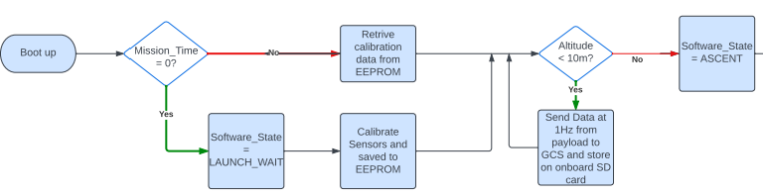
Payload FSW State Diagram (1/4)
Presenter: Max Epstein

Slide 74
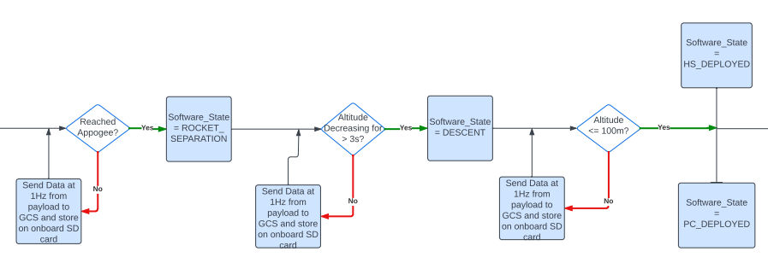
Payload FSW State Diagram (2/4)
Presenter: Max Epstein

Slide 75
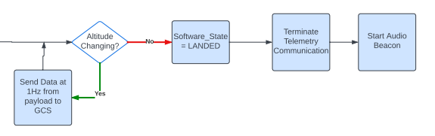
Payload FSW State Diagram (3/4)
Presenter: Max Epstein

Slide 76
Payload FSW State Diagram (4/4)
FSW Recovery from Reset
What is used to recover:
Mission Time
GPS Time
Software State
Altitude
Causes that call for reset:
Power loss (power supply)
Physical damage
Processor failure
Presenter: Evan (Steele) Elliott

Slide 77
Simulation Mode Software
Sensor changes
All air pressure sensors disabled
Simulation mode commands
<MODE> switches from 'F' (Flight) to 'S' (Simulation)
How is simulated sensor data substituted with real data?
External data from text file fed into certain fields instead of air pressure sensor readings
<ALTITUDE>, <PRESSURE>
All other sensor readings & telemetry remain the same
Presenter: Evan (Steele) Elliott

Slide 78
Software Development Plan (1/2)
Prototyping and Prototyping Environments
Environment in Visual Studio Code and Arduino IDE
Modular code parts
Development Team
Steele Elliott
Max Epstein
Test Methodology
Simulation mode with varying datasets
Freefall sensor testing
Presenter: Evan (Steele) Elliott

Slide 79
Software Development Plan (2/2)
Subsystem | Development Sequence
Sensors | Sensor trade and selection compare and select the best Program each individual sensor in Arduino Integrate and conglomerate all programs, make sure it still functions
Xbee Radio | Configure and test point to point communication for the radio (controller and GCS port) Integrate sensors with Xbee for data transmission
Flight Control | Program feedback system with servos connected to flight mechanisms
Release Mechanisms | Program release mechanisms such as linear actuators and servos
Software State | Use the data from sensors to change the states
Audio Beacon | Program locator audio beacon
Integration | Integrate all software subsystem and ensure 1Hz data transmission from payload. Also, to make sure the software states match up with what is occurring.
Presenter: Evan (Steele) Elliott

Slide 80
Ground Control System (GCS) Design
Evan (Steele) Elliott, Sanat Konda

Slide 81
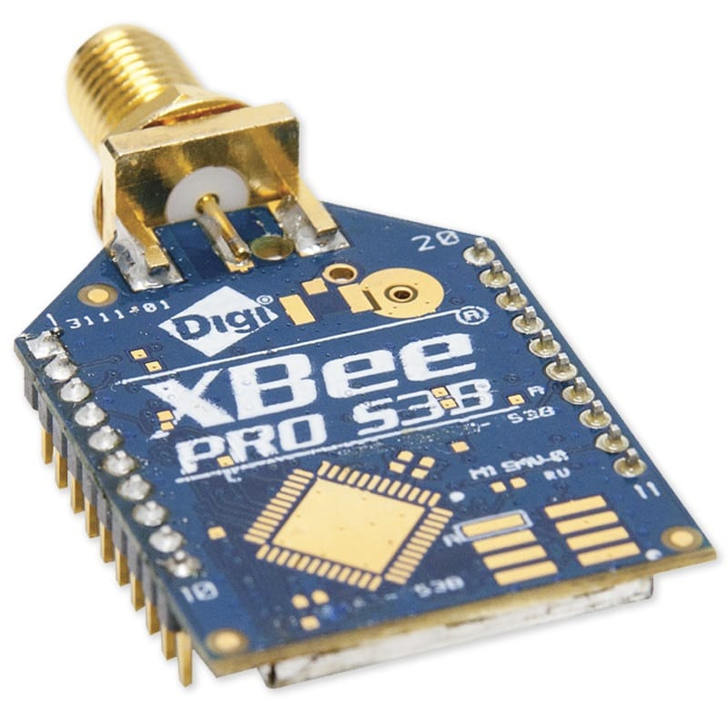
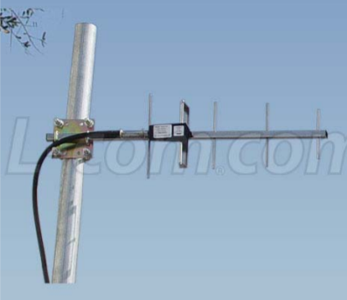


GCS Overview
Flight Software
Presenter: Sanat Konda

Slide 82


GCS Design
Specifications​
Laptop Battery | 4 Hours
Overheating Mitigation | Umbrella, Laptop Cooler, and Jacket
Auto update Mitigation | Disable Auto-Update
Presenter: Sanat Konda

Slide 83


GCS Antenna Trade & Selection
Name​ | Frequency ​ Range (GHz)​ | Length of Antenna (mm)​ | Gain (dBi)​ | Polarization | Connection Type​ | Weight (g) | Cost ($)
Right-Angle Mini GSM | .85-2.1 | 57​ | ​2​ | (Linear) Vertical | Right Angle SMA | 8 | 4.95
TL-Dipole Swivel Antenna | ​2.4 | 200​ | 5​ | (Linear) Vertical | RP-​SMA​ | 30 | 8.95
900 MHz 14 dBi Al Yagi Antenna | .90-.928 | 1422 | 14 | Linear | N-Female | 680 | 72.32
Selection​ | Reasoning for selection​
Yagi Antenna | - Gain strength immensely stronger than the other antennas - Larger antenna - Ideal frequency range - Handheld, easy to maneuver - Previous use and accessibility
Presenter: Sanat Konda

Slide 84
GCS Software (1/3)
Software Packages:
• Python 3.11.5 - Computational environment of choice
• XCTU – XBee Program Software
• XBEE Python Library – real time access to XBEE via USB interface
• Matplotlib Python Library – real time plotting and data manipulation
• PySimpleGUI Python Library – visual design layout and manipulation
• Pandas Python Library – real time data collection and .csv file status
Command Software and Interface:
• Commands can be sent from the Ground Control Station to the CanSat via command.
• The GCS uses the XBEE Python Library to access the XBEE receiver through the USB interface.
Telemetry Data Recording:
• Telemetry will be saved in a .csv file without manipulation after being read via USB interface.
• .csv data will be analyzed in python and presented via GUI and saved in file.
CSV File Generation:
• .csv file will be generated in GCS Python software for payload and data will be continuously added to the created file as it arrives in packets to GCS.
Simulation Mode:
Opens simulation data .csv file and simulates reading commands at frequency of 1 Hz,
Presenter: Evan (Steele) Elliott

Slide 85

GCS Software (2/3)
Presenter: Evan (Steele) Elliott

Slide 86

GCS Software (3/3)
Presenter: Evan (Steele) Elliott

Slide 87
CanSat Integration and Test
Evan (Steele) Elliott, Max Epstein, Melissa Gonzalez

Slide 88
CanSat Integration and Test Overview
CanSat Integration and Test Overview
Subsystem Level Test Plan
Integrated Level Functional Test Plan
Environmental Test Plan
Simulation Test Plan
Presenter: Melissa Gonzalez

Slide 89
Subsystem Level Testing Plan (1/2)
Subsystem Level Testing​
Sensors​ | - Pressure sensor tests - Temperature sensor tests - GPS location & time tests​ - Rotational Sensors tests - Camera recording and saving video tests
CDH​ | - Processor clock speed tests​ - EEPROM storage size tests​ - EEPROM read/write speed tests​
EPS​ | - Battery voltage readings​ - Impedance tests on each component​ - Battery power output & tolerance tests​
Radio Communications | - XBEE radio receiver/sender tests - Antenna signal quality tests - Packet receival and transmission tests
Presenter: Max Epstein

Slide 90
Subsystem Level Testing Plan (2/2)
Subsystem Level Testing​
FSW​ | - Data live graph generation tests - Simulation mode tests - CSV data saving & handling - Software states testing
Mechanical​ | - Container & probe structural tests - Probe deployment tests - Probe upright testing - Avionics bay structural integrity tests - Parachute deployment release tests - Probe stability control tests - Flag raising test
Descent Control​ | - Parachute Drogue tests - Parachute reefing tests - Parachute deployment tests - Aerobraking device testing
Presenter: Max Epstein

Slide 91
Integrated Level Functional Test Plan
Testing Plan
Decent Testing | - PID Controller payload descent rate tests
Communications | - Telemetry transmission and retrieval tests - Communication between GCS and Payload
Mechanisms | - Payload release mechanism tests - Payload stability control tests - Aerobrake release mechanism tests - Flag deployment mechanism tests - Payload parachute release mechanism tests
Deployment | - Payload deployment tests are various altitudes - Payload parachute deployments tests at various altitudes - Aerobrake deployments tests are various altitudes - Linear actuator integration with altitude sensor readings
Presenter: Melissa Gonzalez

Slide 92
Environmental Test Plan (1/2)
Drop Test​
Verify that all structures can survive 15 Gs of launch acceleration and 30 Gs of shock​
Thermal Test
Verify the CanSat can operate in a hot environment without materials and/or components becoming functionally compromised​
Vibration Test
Verify the structural integrity of all mounts and connections within the CanSat​
Verify that the container can survive deployment from rocket​
Verify that payload remains in stowed state
Verify that component and battery mounts can withstand applied forces
Verify that payload remains in stowed state
Fit Check
Verify that the CanSat and container fits within rocket to minimize deployment failure
Vacuum Test
Verify deployment operations of the payload
Presenter: Melissa Gonzalez

Slide 93
Environmental Test Plan (2/2)
Drop Test
Thermal Test
Vibration Test
Fit Check
Vacuum Test
Plan: Secure the CanSat to testing rig with non-stretch cord, release the CanSat from 61 cm and allow it to freefall, inspect CanSat for damage, if there was no damage then run a functional test.
Plan: Place the CanSat in an insulating cooler with a hair dryer, use a remote thermometer to monitor temperature, turn on the CanSat, turn off the heat source once internal temperatures reach 60C and turn on heat sources when temperature reaches 55C. Main this for 2 hours. With heat source off, visually inspect and functionally test CanSat to verify operational integrity survived thermal exposure​.
Plan: Attach the CanSat to a random orbital sander and power it up to full speed, wait 5 seconds after the sander is at full speed then power it off, repeat the process 5 more times. Remove CanSat from fixture and visually inspect and functionally test CanSat to verify operation integrity. Verify accelerometer data is still being collected.
Plan: Construct a prototype of the rocket cylinder wall, place the CanSat inside of the prototype and check for proper fit as well as the ability to securely deploy.
Plan: Construct a vacuum chamber using a bucket and a vacuum cleaner. Suspend fully configured and powered CanSat within the vacuum chamber and turn on the vacuum. Monitor telemetry and stop the vacuum once peak altitude has been reached. Let air enter vacuum chamber slowly and monitor operation of CanSat. Collect and save telemetry. Save telemetry for judge reviewal.
Presenter: Melissa Gonzalez

Slide 94
Simulation Test Plan
How simulation works
After configuration, once the SIM ENABLE and SIM ACTIVATE commands are ran, simulation mode will run.
The ground station will transmit pressure data from a csv file at 1Hz intervals to the payload.
What parts are tested
The configuration and echoing of commands.
The flight software will determine altitude using radio linked values instead of live sensor data.
The flight software will detect the launch and release payload and parachute at respective altitudes.
Lastly, the mast will be raised and the audio beacon will begin once landing is detected
The deployment of payload parachute, mast raise, and trigger of audio beacon.
The calculation of altitude with fed data from the CSV.
Payload video is saved and pointing in the correct direction.
Presenter: Evan (Steele) Elliott

Slide 95
Mission Operations & Analysis
Max Epstein, Melissa Gonzalez

Slide 96

Overview of Mission Sequence of Events (1/2)
Flowchart
Presenter: Max Epstein

Slide 97
Overview of Mission Sequence of Events (2/2)
Roles & Responsibilities
• Mission Control Officer – Melissa Gonzalez
• Ground Station Crew – Evan (Steele) Elliott, Max Epstein, Jonathan (Yoni) Gutmann
• Recovery Crew – Sanat Konda, Christian Roque
• CanSat Crew – Zachary DeFabrizio, Jake Edwards, Samuel Taylor, Melanie Miguel
Antenna Construction & Ground System Setup
• Handheld ground station antenna will be mounted to a wood plank to be easily handled and aimed before competition date
• Ground system will be setup by Ground Station Crew, this includes the adapters necessary for the ground station antenna and XBEE radio
Presenter: Melissa Gonzalez

Slide 98
Mission Operations Manual Development Plan
Mission Operations Manual Outline:​
CGS Configuration:
Indicates the status of the GCS, antennas, and flight software for final pre-flight checks.
CanSat Preparation and Assembly:
Indicates the assembly of the CanSat, damage inspection, and assembly of components
CanSat-Rocket Integration:
Indicates a final checklist and procedure for rocket clearances and assembly inspections.
Launch Preparation:​
Provided by CanSat competition.​
Launch Procedure:​
Provided by CanSat competition.​
Removal Procedure:​
Provided by CanSat competition.
Presenter: Max Epstein

Slide 99
CanSat Location and Recovery
Recovery Crew will be responsible for container and payload recovery
Container & Parachute will be a bright pink color making them easier to identify and locate.
Most recently logged position on GPS will be used to more accurately locate the payload
Contact information and return address labels will be on both the container and the payload
Presenter: Melissa Gonzalez

Slide 100
Requirements Compliance
Max Epstein

Slide 101
Requirements Compliance Overview
Eggsplorer 1 complies with the requirements of the CanSat 2024 mission
The requirement compliance was measure using three conditions which are detailed below: Full Compliance, Partial Compliance, and No Compliance.
Full Compliance​ | The CanSat project complies 68/73 mission requirements
Partial​ Compliance | There are 5 requirements partially satisfied by our CanSat. This means that the requirement is technically met but will require further analysis and testing for finalization.
No Compliance | There are 0 requirements our current build does not comply to.
Presenter: Max Epstein

Slide 102
Requirements Compliance (1/7)
Req # | Description | Comply / No Comply/ Partial | X-Ref Slide(s) Demonstrating Compliance | Team Comments or notes
C1 | The CanSat will act as the nose cone during the rocket’s ascent portion of the flight. | Comply | 15, 18
C2 | The CanSat shall be deployed when the ejection charge fires. | Comply | 20
C3 | After deployment, the CanSat shall deploy its heat shield/aerobraking mechanism. | Comply | 45, 46
C4 | A silver or gold mylar streamer of 50mm and 1.5 meters in length shall be connected to the CanSat and released at deployment, used to locate and identify the CanSat. | Partial |  | Not shown, but is planned for
C5 | At 100 meters, the CanSat shall deploy a parachute and release the heat shield. | Comply | 47, 48
C6 | Upon landing, the CanSat shall stop transmitting data. | Comply | 71
C7 | Upon landing, the CanSat shall activate and audio beacon. | Partial | 67 | To be added
C8 | The CanSat shall carry a provided large hen’s egg with a weight between 51 and 65 grams. | Comply | 15
C9 | 0 altitude reference shall be at the launch pad. | Comply | 71
C10 | During descent with the heat shield deployed, the descent rate shall be between 10 and 30 m/s. | Comply | 40
C11 | At 100 meters, the CanSat shall have a descent rate of less than 5 m/s. | Comply | 40
C12 | Total cost of the CanSat shall be below $1000. Ground support and analysis equipment are not included in this cost. Equipment from previous years shall be included at current market price. | Comply | 113
Presenter: Max Epstein

Slide 103
Requirements Compliance (2/7)
Req # | Description | Comply / No Comply/ Partial | X-Ref Slide(s) Demonstrating Compliance | Team Comments or notes
S1 | The CanSat mass shall be 900 grams +/- 10 grams without the egg. | Comply | 51, 52, 53
S2 | The nose cone shall be symmetrical along the thrust axis. | Comply | 36
S3 | The nose cone radius shall be exactly 71 mm. | Comply | 20
S4 | The nose cone shoulder radius shall be exactly 68 mm. | Comply | 20
S5 | The nose cone shoulder length shall be a minimum of 50 mm. | Comply | 20
S6 | CanSat structure must be able to survive 15 Gs vibration. | Partial |  | Needs testing (Vibration Test)
S7 | CanSat shall must survive 30 Gs shock. | Partial |  | Needs testing (Drop Test)
S8 | The CanSat shall perform the function of the nose cone during rocket ascent. | Comply | 18
S9 | The rocket airframe can be used to restrain any deployable parts of the CanSat, but shall allow the CanSat to slide out of the payload section freely. | Comply | 20
S10 | The rocket airframe can be used as part of the CanSat operations. | Comply | 20, 44, 46
S11 | All electronics and mechanical components shall be hard mounted using proper mounts such as standoffs, screws, or high performance adhesives. | Comply | 50
Presenter: Max Epstein

Slide 104
Requirements Compliance (3/7)
Req # | Description | Comply / No Comply/ Partial | X-Ref Slide(s) Demonstrating Compliance | Team Comments or notes
M1 | No pyrotechnical or chemical actuators are allowed. | Comply | 42
M2 | Mechanisms that use heat shall not be exposed to the outside environment to reduce risk of setting the vegetation on fire. | Comply | 42
M3 | All mechanisms shall be capable of maintaining their configuration or states under all forces. | Partial |  | Needs testing (Drop Test)
M4 | Spring contacts shall not be used for making electrical connections to batteries as shock forces can case momentary disconnects. | Comply | 65
M5 | The CanSat shall deploy a heat shield after deploying from the rocket. | Comply | 46
M6 | The heat shield shall be used as an aerobrake and limit the descent rate to 10 to 30 m/s. | Comply | 40
M7 | At 100 meters, the CanSat shall release a parachute to reduce the descent rate to less than 5 m/s. | Comply | 33, 40
M8 | The CanSat shall protect a hen’s egg from damage during all portions of the flight. | Comply | 49
M9 | If the nose cone is to be considered part of the heat shield, the documentation shall identify the configuration. | Comply | 32
M10 | After the CanSat has separated from the rocket, and if the nose cone portion of the CanSat is to be separated from the rest of the CanSat, the nose cone portion shall descent at less than 10 m/s using any type of descent control device. | Comply | 40
Presenter: Max Epstein

Slide 105
Requirements Compliance (4/7)
Req # | Description | Comply / No Comply/ Partial | X-Ref Slide(s) Demonstrating Compliance | Team Comments or notes
E1 | Lithium polymer batteries are not allowed. | Comply | 68
E2 | Battery source may be alkaline, Ni-Cad, NiMH or Lithium. Lithium cells must be manufactured with a metal package similar to 18650 cells. Coin cells are allowed. | Comply | 68
E3 | The power switch must be easily accessible. | Comply | 66
E4 | There must be a power indicator. | Comply | 67
E5 | The CanSat shall operate for a minimum of two hours when integrated into the rocket | Comply | 69
X1 | XBEE radios shall be used for telemetry. 2.4 GHz Series in addition to 900 MHz Series are allowed. | Comply | 81
X2 | XBEE radios shall have their NETID/PANID set to their team number. | Comply | 81
X3 | XBEE radios shall not use broadcast mode. | Comply | 81
X4 | The CanSat shall transmit telemetry once per second. | Comply | 60
X5 | The CanSat telemetry shall include altitude, air pressure, temperature, battery voltage, tilt angles, air speed, command echo, and GPS coordinates which include latitude, longitude, altitude, and number of satellites. | Comply | 22
Presenter: Max Epstein

Slide 106
Requirements Compliance (5/7)
Req # | Description | Comply / No Comply/ Partial | X-Ref Slide(s) Demonstrating Compliance | Team Comments or notes
SN1 | CanSat shall measure its speed with a pitot tube during both ascent and descent. | Comply | 26
SN1 | CanSat shall measure its altitude using air pressure. | Comply | 23
SN3 | CanSat shall measure its internal temperature. | Comply | 24
SN4 | CanSat shall measure its angle stability with the aerobraking mechanism deployed. | Comply | 27
SN5 | CanSat shall measure its rotation rate during descent. | Comply | 28
SN6 | CanSat shall measure its battery voltage. | Comply | 25
SN7 | The CanSat shall include a video camera pointing horizontally. | Comply | 30
SN8 | The video camera shall record the flight of the CanSat from launch to landing. | Comply | 30
SN9 | The video camera shall record video in color and with a minimum resolution of 640x480. | Comply | 30
Presenter: Max Epstein

Slide 107
Requirements Compliance (6/7)
Req # | Description | Comply / No Comply/ Partial | X-Ref Slide(s) Demonstrating Compliance | Team Comments or notes
G1 | The ground station shall command the CanSat to calibrate the altitude to zero when the CanSat is on the launch pad prior to launch. | Comply | 73
G2 | The ground station shall generate csv files of all sensor data as specified in the Telemetry Requirements section. | Comply | 84
G3 | Telemetry shall include mission time with 1 second or better resolution. | Comply | 57
G4 | Configuration states such as zero altitude calibration shall be maintained in the event of a processor reset during launch and mission. | Comply | 73
G5 | Each team shall develop their own ground station. | Comply | 81
G6 | All telemetry shall be displayed in real time during descent on the ground station. | Comply | 85
G7 | All telemetry shall be displayed in engineering units and the units shall be indicated on the displays. | Comply | 85
G8 | Teams shall plot each telemetry data field in real time. | Comply | 85
G9 | The ground station shall include one laptop computer with a minimum of two hours battery operation, XBEE radio, and an antenna. | Comply | 82
G10 | The ground station must be portable so that the team can be positioned at the ground station operation site along the flight line. AC power will be not available. | Comply | 82
G11 | The ground station software shall be able to command the payload to operate in simulation mode by sending two commands, SIMULATION ENABLE and SIMULATION ACTIVATE. | Comply | 77
Presenter: Max Epstein

Slide 108
Requirements Compliance (7/7)
Req # | Description | Comply / No Comply/ Partial | X-Ref Slide(s) Demonstrating Compliance | Team Comments or notes
G12 | When in simulation mode, the ground station shall transmit pressure data from a csv file provided by the competition at 1 Hz interval to the CanSat. | Comply | 60
G13 | The ground station shall use a tabletop or handheld antenna. | Comply | 83
G14 | The displays on the ground station shall be designed with larger fonts (14pt minimum), bold plot traces and axes, and dark text on a light background since the ground station will be viewed in bright sunlight. | Comply | 85
G15 | The ground system shall count the number of received packets. This is not the number of transmitted packets, but the number of packets successfully received at the ground station. | Comply | 85
F1 | The flight software shall maintain a count of packets transmitted which shall increment with each packet transmission through the mission. This value shall be maintained through processor resets. | Comply | 85
F2 | The CanSat shall maintain mission time throughout the whole mission regardless of processor resets or power loss. | Comply | 85
F3 | The CanSat shall have its time set to within one second UTC time prior to launch. | Comply | 57
F4 | The flight software shall support simulated flight mode where the ground station sends air pressure values at a one second interval using a provided flight profile csv file. | Comply | 77
F5 | In simulation mode, the flight software shall use the radio uplink pressure values in place of the pressure sensor for determining the payload altitude. | Comply | 77
F6 | The payload flight software shall only enter simulation mode after it receives the SIMULATION ENABLE and SIMULATION ACTIVE commands. | Comply | 77
Presenter: Max Epstein

Slide 109
Management
Max Epstein, Melissa Gonzalez

Slide 110
CanSat Budget – Hardware
Component​ | Quantity​ | Unit Price ($)​ | Total Price ($)​ | Value Type​
Adafruit BMP280 | 1 | 9.95 | 9.95 | Actual​
BNO-055 | 1​ | 34.95 | 34.95​ | Actual​
Adafruit Ultimate | 1 | 29.95​ | 29.95 | Actual​
Arduino Nano | 1​ | 25.00 | 25.00 | Actual​
ANT-900-RP-2-A | 1​ | 3.99​ | 3.99​ | Actual​
ESP 32 | 1 | 9.99 | 9.99 | Actual​
Mirco SD cards | 1​ | 4.20​ | 4.20​ | Actual​
PX4 Pitot Tube | 1 | 55.88 | 55.88 | Actual​
XBEE Pro 900 Mhz Radio | 1 | 68.25​ | 68.25 | Actual​
9 Volt Battery | 1​ | 1.62 | 1.62 | Actual​
INA 260 | 1 | 6.38 | 6.38 | Actual​
Linear Actuator | 1 | 65.00 | 65.00 | Actual
Servo Motor | 1 | 8.84 | 8.84 | Actual
Presenter: Max Epstein

Slide 111
CanSat Budget – Hardware
Component​ | Quantity​ | Unit Price ($)​ | Total Price ($)​ | Value Type​
Threaded Aluminum Rod | 3 | 3.67 | 11.01 | Actual​
Nut | 18 | 2.09 | 37.58 | Actual​
Fiberglass Eyebolt | 1 | 8.12 | 8.12 | Actual​
Torsion Spring | 4 | 1.63 | 6.51 | Actual​
Parachute | 1 | 36.50 | 36.50 | Actual​
Mylar Fabric | 1 | 26.00 | 26.00 | Actual​
Elastic Bands | 2 | 0.85 | 1.70 | Actual​
High Performance Adhesive | 1 | 3.88 | 3.88 | Actual​
Memory Foam | 1 | 10.00 | 10.00 | Actual
Presenter: Max Epstein

Slide 112
CanSat Budget – Other Costs (1/2)
Component​ | Quantity​ | Unit Price ($)​ | Total Price ($)​ | Value Type​
Ground Station​ | -​ | -​ | -​ | -​
Xbee USB Shield​ | 1​ | 26.00​ | 26.00​ | Actual​
900 MHz 14 dBi Al Yagi Antenna - reuse | 1​ | 72.32​ | 72.32 | Actual​
900 MHz XBEE Radio - reuse | 1​ | 68.25 | 68.25 | Actual​
Laptop​ | 1​ | 1​ | 0​ | Provided by Team Member​
Prototyping ​ | 1​ | 1​ | 150.00​ | Estimate​
Test Supplies​ | 1​ | 1​ | 150.00​ | Estimate​
Test Facilities/​ Manufacturing Equipment​ | 1​ | 1​ | 0​ | Covered by University​
Presenter: Max Epstein

Slide 113
CanSat Budget – Other Costs (2/2)
Source of Income:​ | Funds Provided ($):​
UF MAE Department​ | $2,700​
Hardware Costs:​ | $465.30
Other Costs:​ | $466.57
Competition Fees: | $200
Total Costs:​ | $1,131.87
A total cost of $1131.87 for the testing and building of our CanSat as well as CanSat related fees leaves us with a total of $1568.13 for travel, housing, and food expense. This is expected to be more than sufficient for our 10 members. We also have various travel related sponsorships from the university.
Presenter: Max Epstein

Slide 114

Program Schedule Overview
An overview of the competition schedule is shown below, along with a key defining the symbols used in the following detailed schedule.
Key
Design Phase Overview | Task
Important Action | Holiday/Vacation
Presenter: Melissa Gonzalez

Slide 115


Detailed Program Schedule (1/3)
Presenter: Melissa Gonzalez

Slide 116

Detailed Program Schedule (2/3)
Presenter: Melissa Gonzalez

Slide 117

Detailed Program Schedule (3/3)
Presenter: Melissa Gonzalez

Slide 118
Conclusions
Major Accomplishments
All electronics have been purchased and ordered Majority of telemetry components programmed Avionics communication and data handling in progress Significant funding secured Started prototyping CanSat components
Major Unfinished Work
Telemetry communication tests between CanSat and Ground Station Full manufactured prototype of CanSat Some mechanical parts have not been ordered Egg container has not been tested
Presenter: Max Epstein

